Slide 1
Results of data exploration
July 2024
Andrea Corrado

Slide 2
Outline
Data summary and overview
Evaluations on data as population
Evaluation of a priori know characteristics of Rov trace
Comparisons between signals in time domain
Comparisons between signals in frequency domain
Results and Open questions

Slide 3
Outline
Data summary and overview
Evaluations on data as population
Evaluation of a priori know characteristics of Rov trace
Comparisons between signals in time domain
Comparisons between signals in frequency domain
Results and Open questions

Slide 4
Data summary and overview
Data hierarchy
MAP A
MAP B
MAP C
 | Number of records for subjects and maps
Sub | 1 | 2 | 3 | 4 | 5 | 6 | 7 | 8 | 9 | 10 | 11 | 12
MAP A | 97 | 78 | 80 | 193 | 80 | 256 | 11 | 18 | 7 | 11 | 18 | 27
MAP B | 11 | 5 | 22 | 20 | 22 | 14 | 6 | 9 | 7 | 5 | 3 | 18
MAP C | 5 | 7 | 16 | 32 | 16 | 11 | 2 | 11 | 5 | 4 | 5 | 24
For each map, 12 Subjects
For each subject, 5 Traces
Basic observations:
MAP A has on average 73 records for patient in each trace, while for MAP B there are 12 traces and for MAP C 11.
On average, in MAP B the traces have 65% less records compared with MAP A. For MAP C such reduction reaches the 70%.
The dataset is clearly unbalanced.
For each MAP we have (1156 total records):
MAP A: 876 records
MAP B: 142 records
MAP C: 138 records
Rov
Ref
Spare 1 (Ref)
Spare 2
Spare 3
Fc: 2035Hz
Time duration: 1 s
Each trace has the same number of signals collected, which differs within maps and subjects
180 Traces

Slide 5
Outline
Data summary and overview
Evaluations on data as population
Evaluation of a priori know characteristics of Rov trace
Comparisons between signals in time domain
Comparisons between signals in frequency domain
Results and Open questions

Slide 6
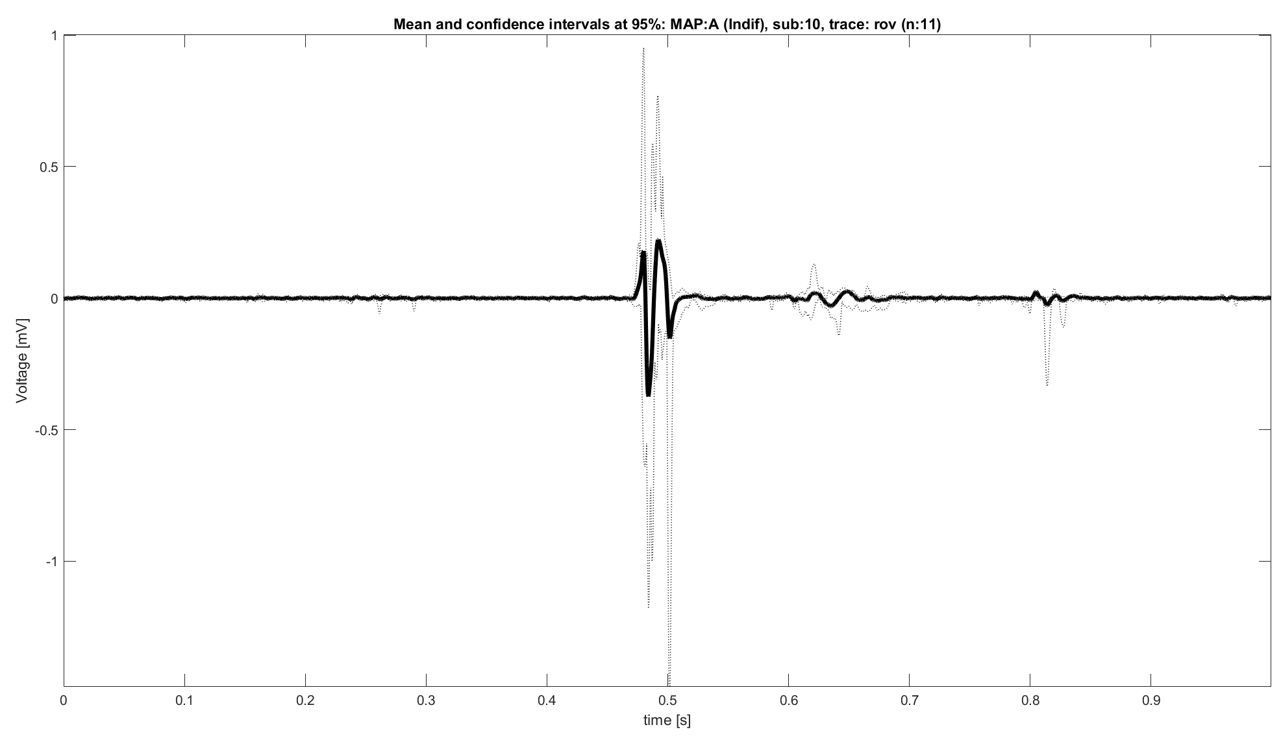
MAP A: Population analysis, expectations
MAP A: indifferent signals
Rov trace expected characteristics:
Amplitude >0.5 mv
Simple and biphasic shape
No slow-path signal
Minor presence of the Ventricular component
Note: figure represents an ideal case

Slide 7
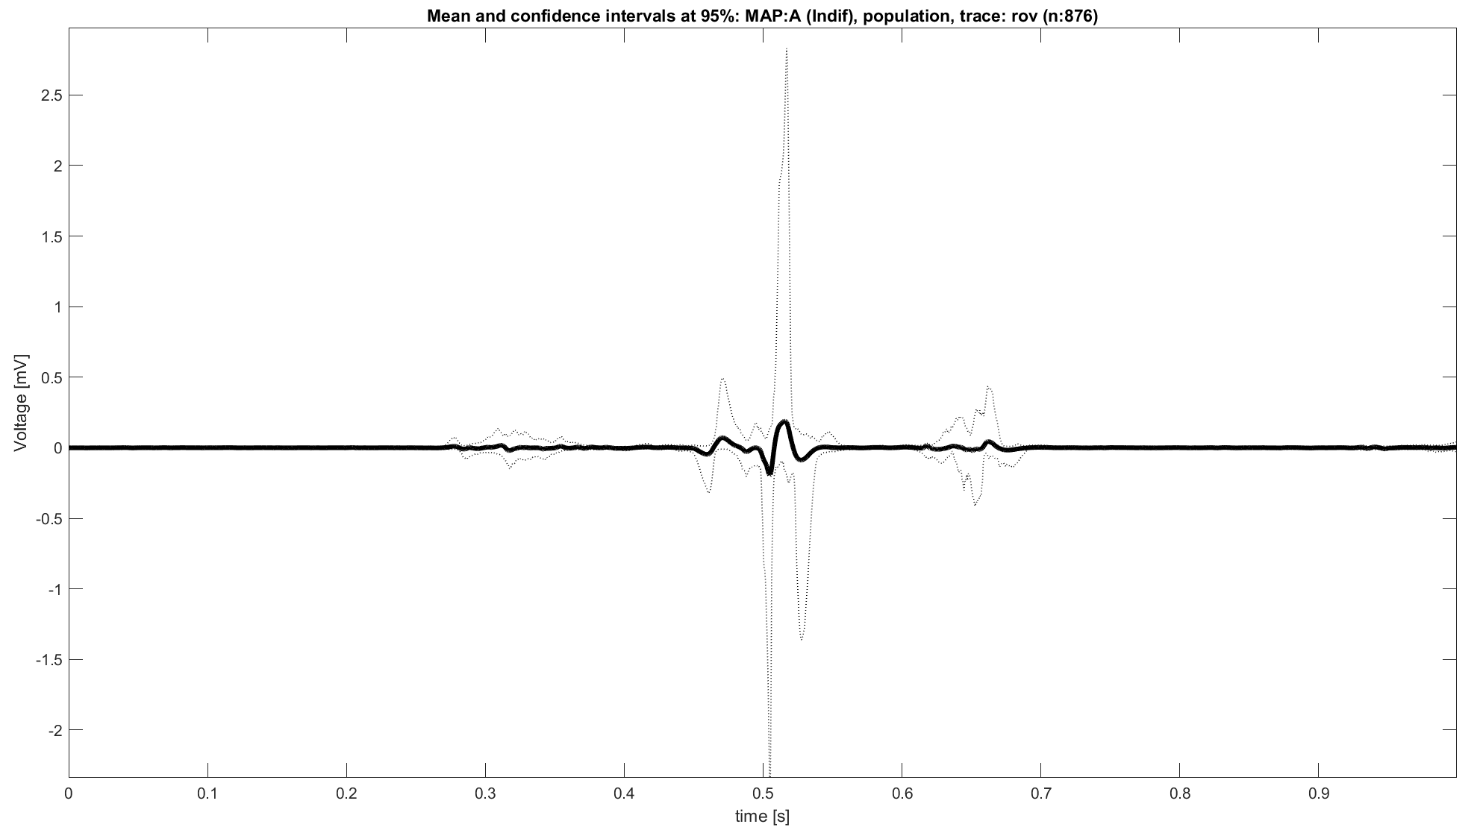
MAP A: Unexpected behaviors
Rov Trace unexpected behaviors
Amplitude slower than 0.5 Mv (on average)
Shape not clearly “simple and biphasic”
Appreciable presence of ventricular signal
Presence of slow path signal

Slide 8
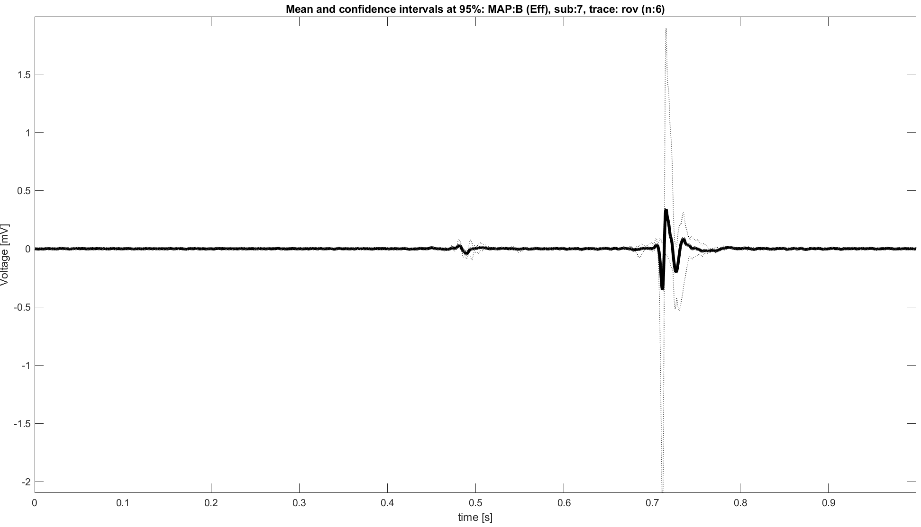
MAP B: Population analysis, expectations
MAP B: effective signals
Rov trace expected characteristics:
Complex atrial component within 0.1 and 0.3 mV
Higher ventricular component
Note: figure represents an ideal case

Slide 9
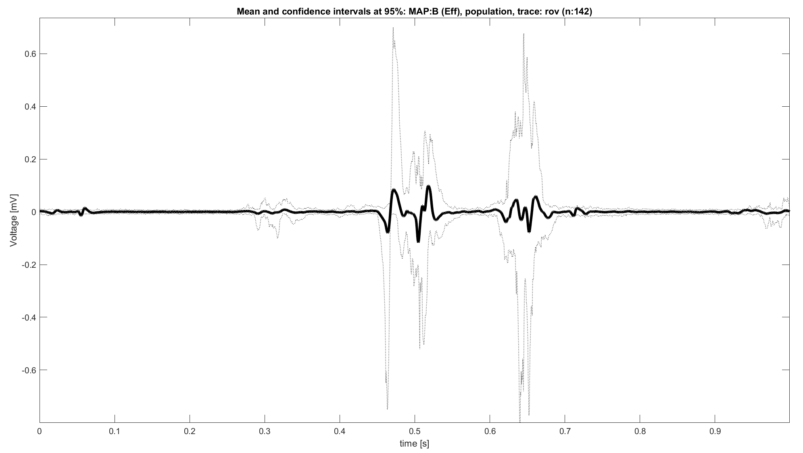
MAP B: Unexpected behaviors
Rov Trace unexpected behaviors
Presence of appreciable atrial contribution
Presence of unclear components before the atrial one

Slide 10
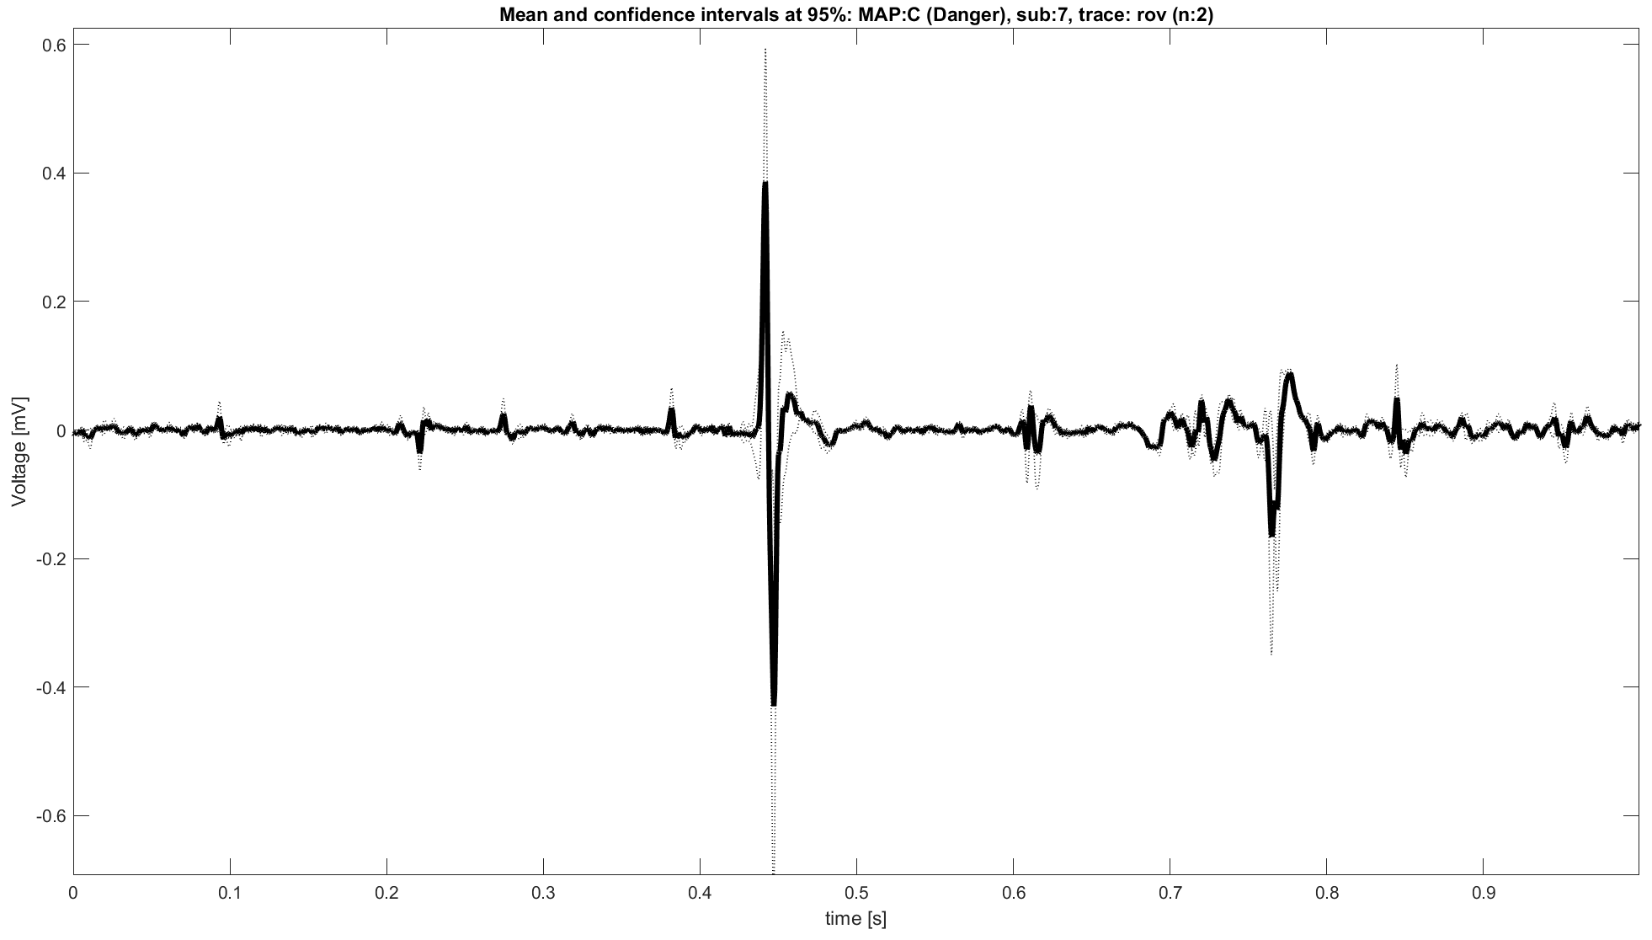
MAP C: Population analysis, expectations
MAP C: dangerous signals
Rov trace expected characteristics:
3 components: atrial activity, ventricular activity and His Bundle passage
Not fixed proportions between atrial and ventricular components
Clear and biphasic atrial component
1
3
2
Note: figure represents an ideal case

Slide 11
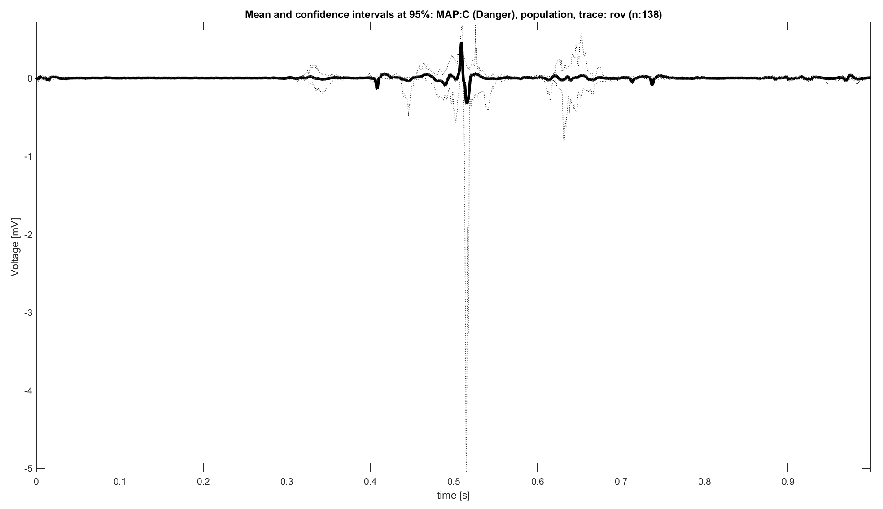
MAP C: Unexpected behaviors
Rov Trace unexpected behaviors
Three components not clearly visible (even looking at confidence intervals)
Presence of components before the atrial contribution
Peaks with unphysiological values
?

Slide 12
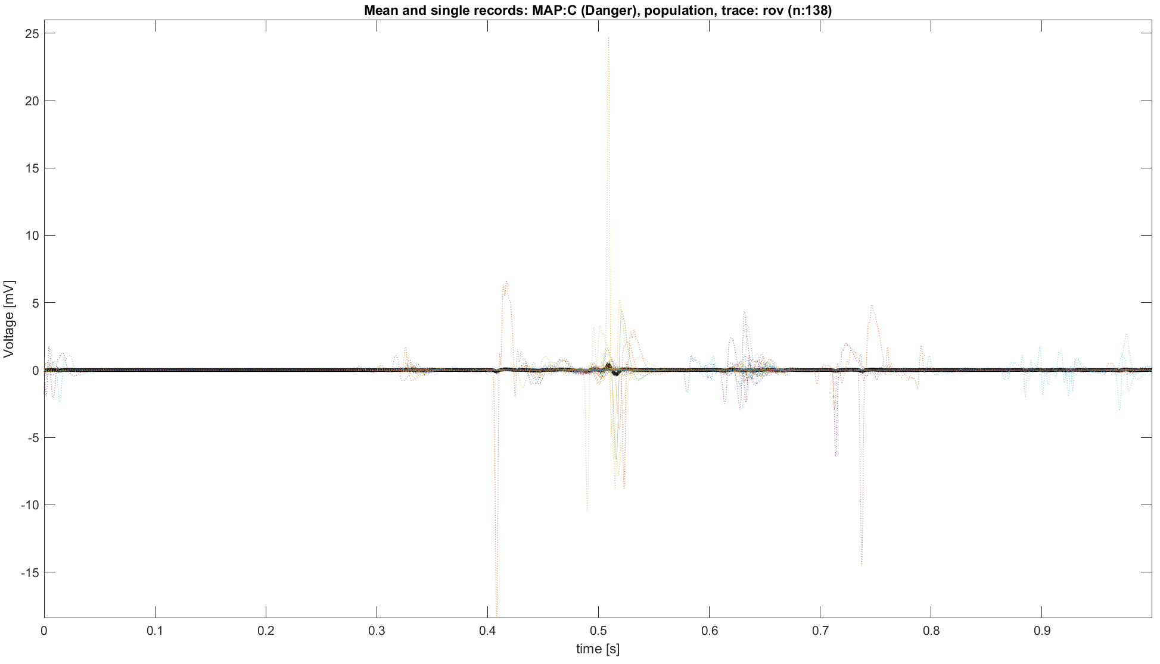
First observations
These first evaluation made using all available signals as a sort of “population” highlights some crucial aspects:
In all MAPs appear appreciable and not expected contributions, even the “smoothing” action of the mean.
In MAP C the “His bundle” contribution is not visible even by looking at the confidence intervals. But other visualizations open a possibility (figure on the right).
These observations, in addition to the ones made before, leads to a question: does the signals need to be aligned? In case, which is the criterion?

Slide 13
Outline
Data summary and overview
Evaluations on data as population
Evaluation of a priori know characteristics of Rov trace
Comparisons between signals in time domain
Comparisons between signals in frequency domain
Results and Open questions

Slide 14
MAP A: Expectations
MAP A: indifferent signals
Rov trace expected characteristics:
Amplitude >0.5 mv
Simple and biphasic shape
No slow-path signal
Minor presence of the Ventricular component

Slide 15
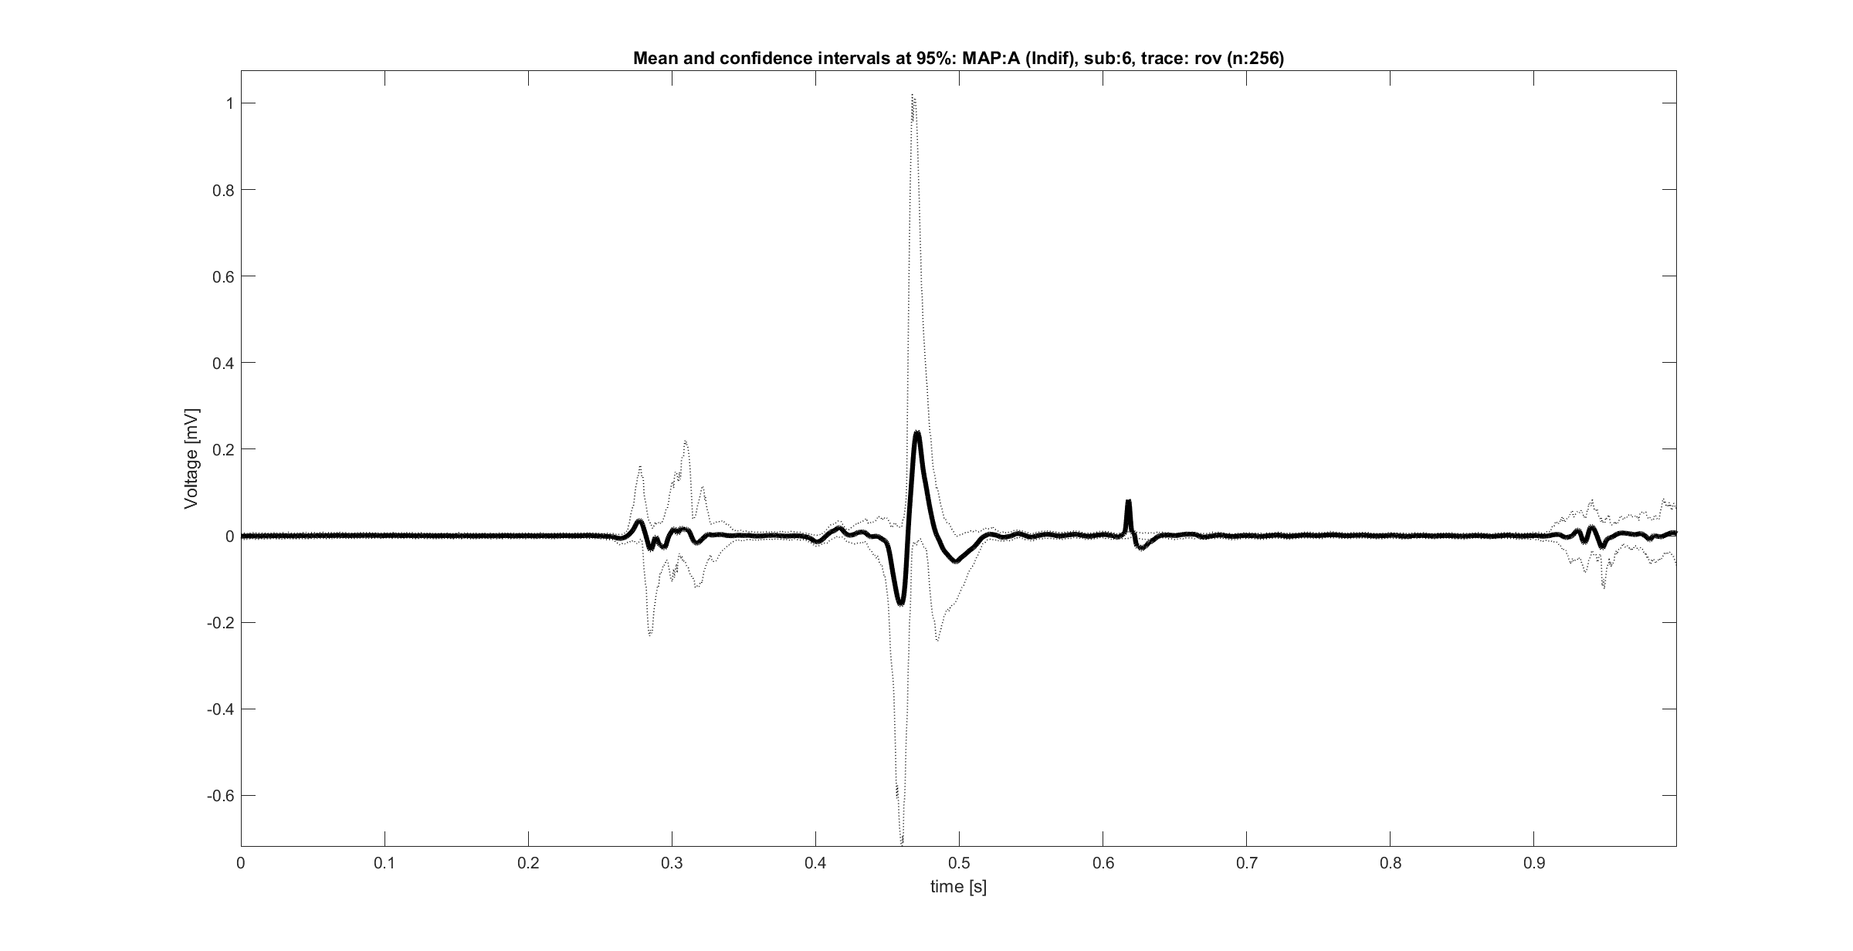
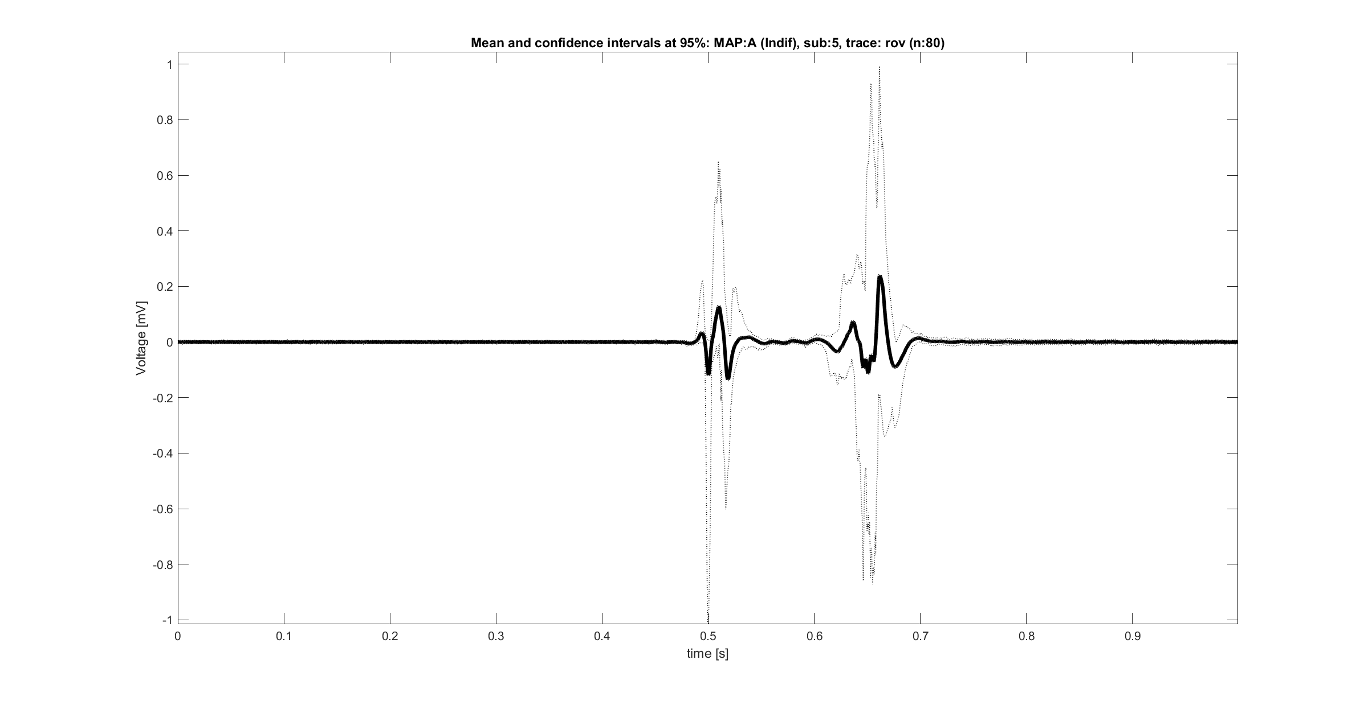
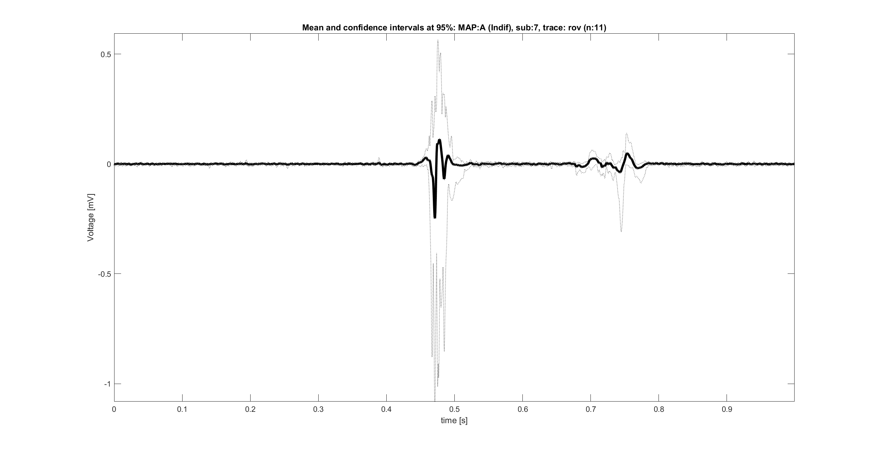
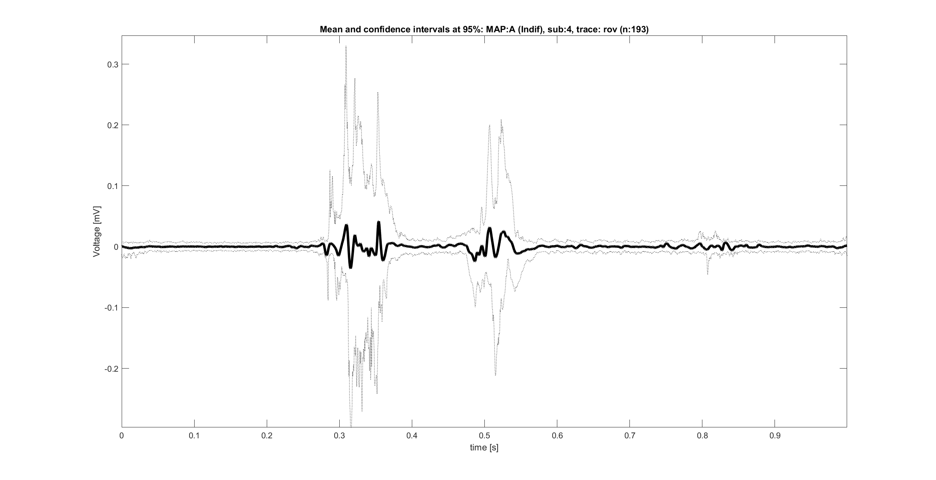
MAP A: Unexpected behaviors
Rov Trace unexpected behaviors
Amplitude slower than 0.5 Mv
Shape not always “simple and biphasic”
Appreciable presence of ventricular signal
Presence of slow path signal

Slide 16
MAP B: Expectations
MAP B: effective signals
Rov trace expected characteristics:
Complex atrial component within 0.1 and 0.3 mV
Higher ventricular component

Slide 17
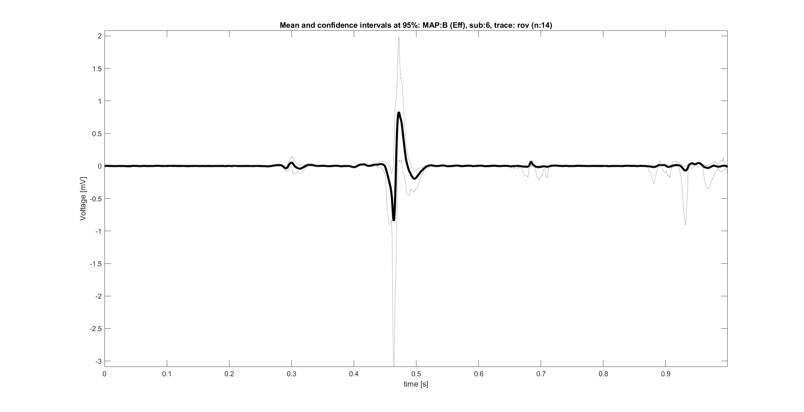
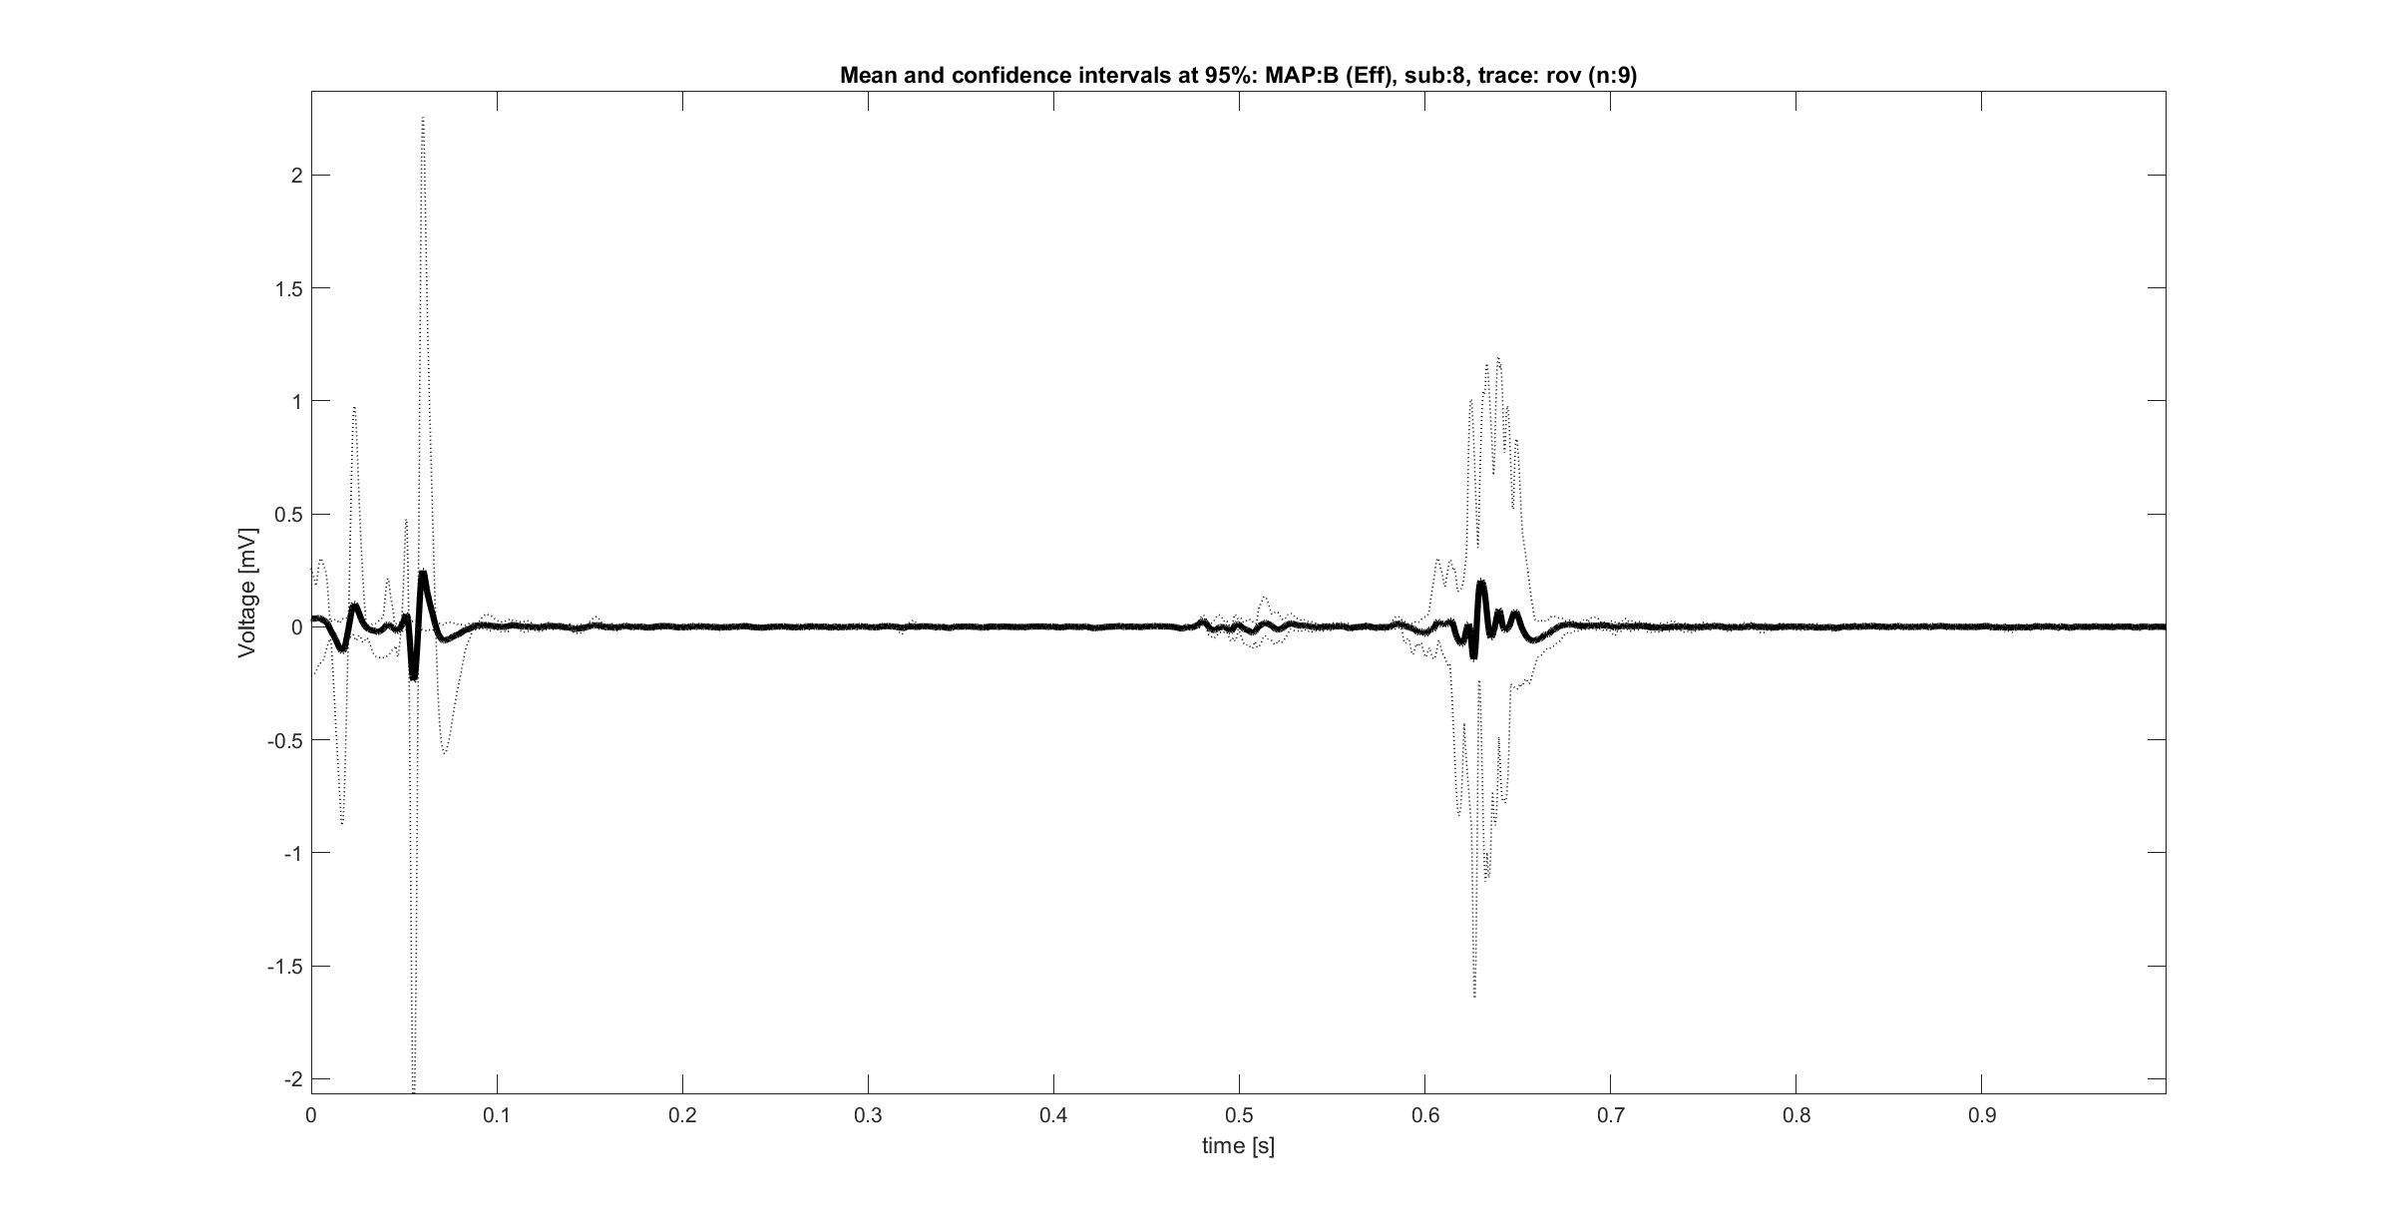
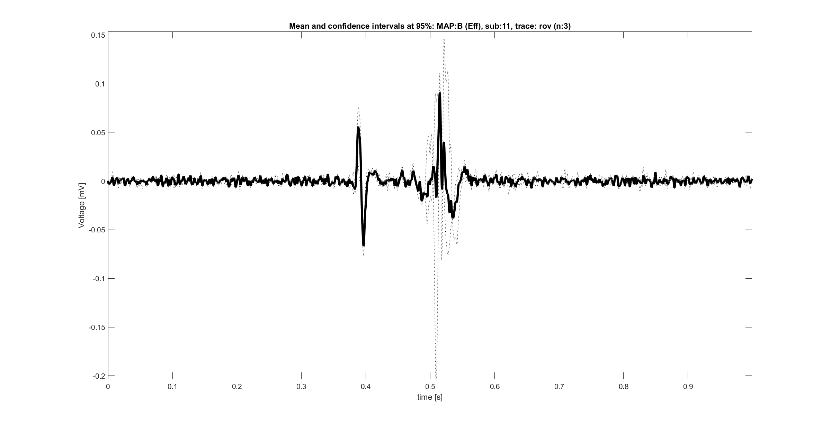
MAP B: Unexpected behaviors
Rov Trace unexpected behaviors
Very noisy signals
Presence of spurious components at the beginning of the signal
(TBC) presence of MAP A signals

Slide 18
MAP C: Expectations
MAP C: dangerous signals
Rov trace expected characteristics:
3 components: atrial activity, ventricular activity and His Bundle passage
Not fixed proportions between atrial and ventricular components
Clear and biphasic atrial component
1
3
2

Slide 19
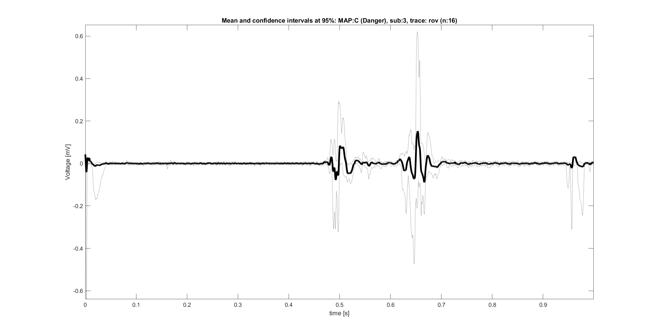
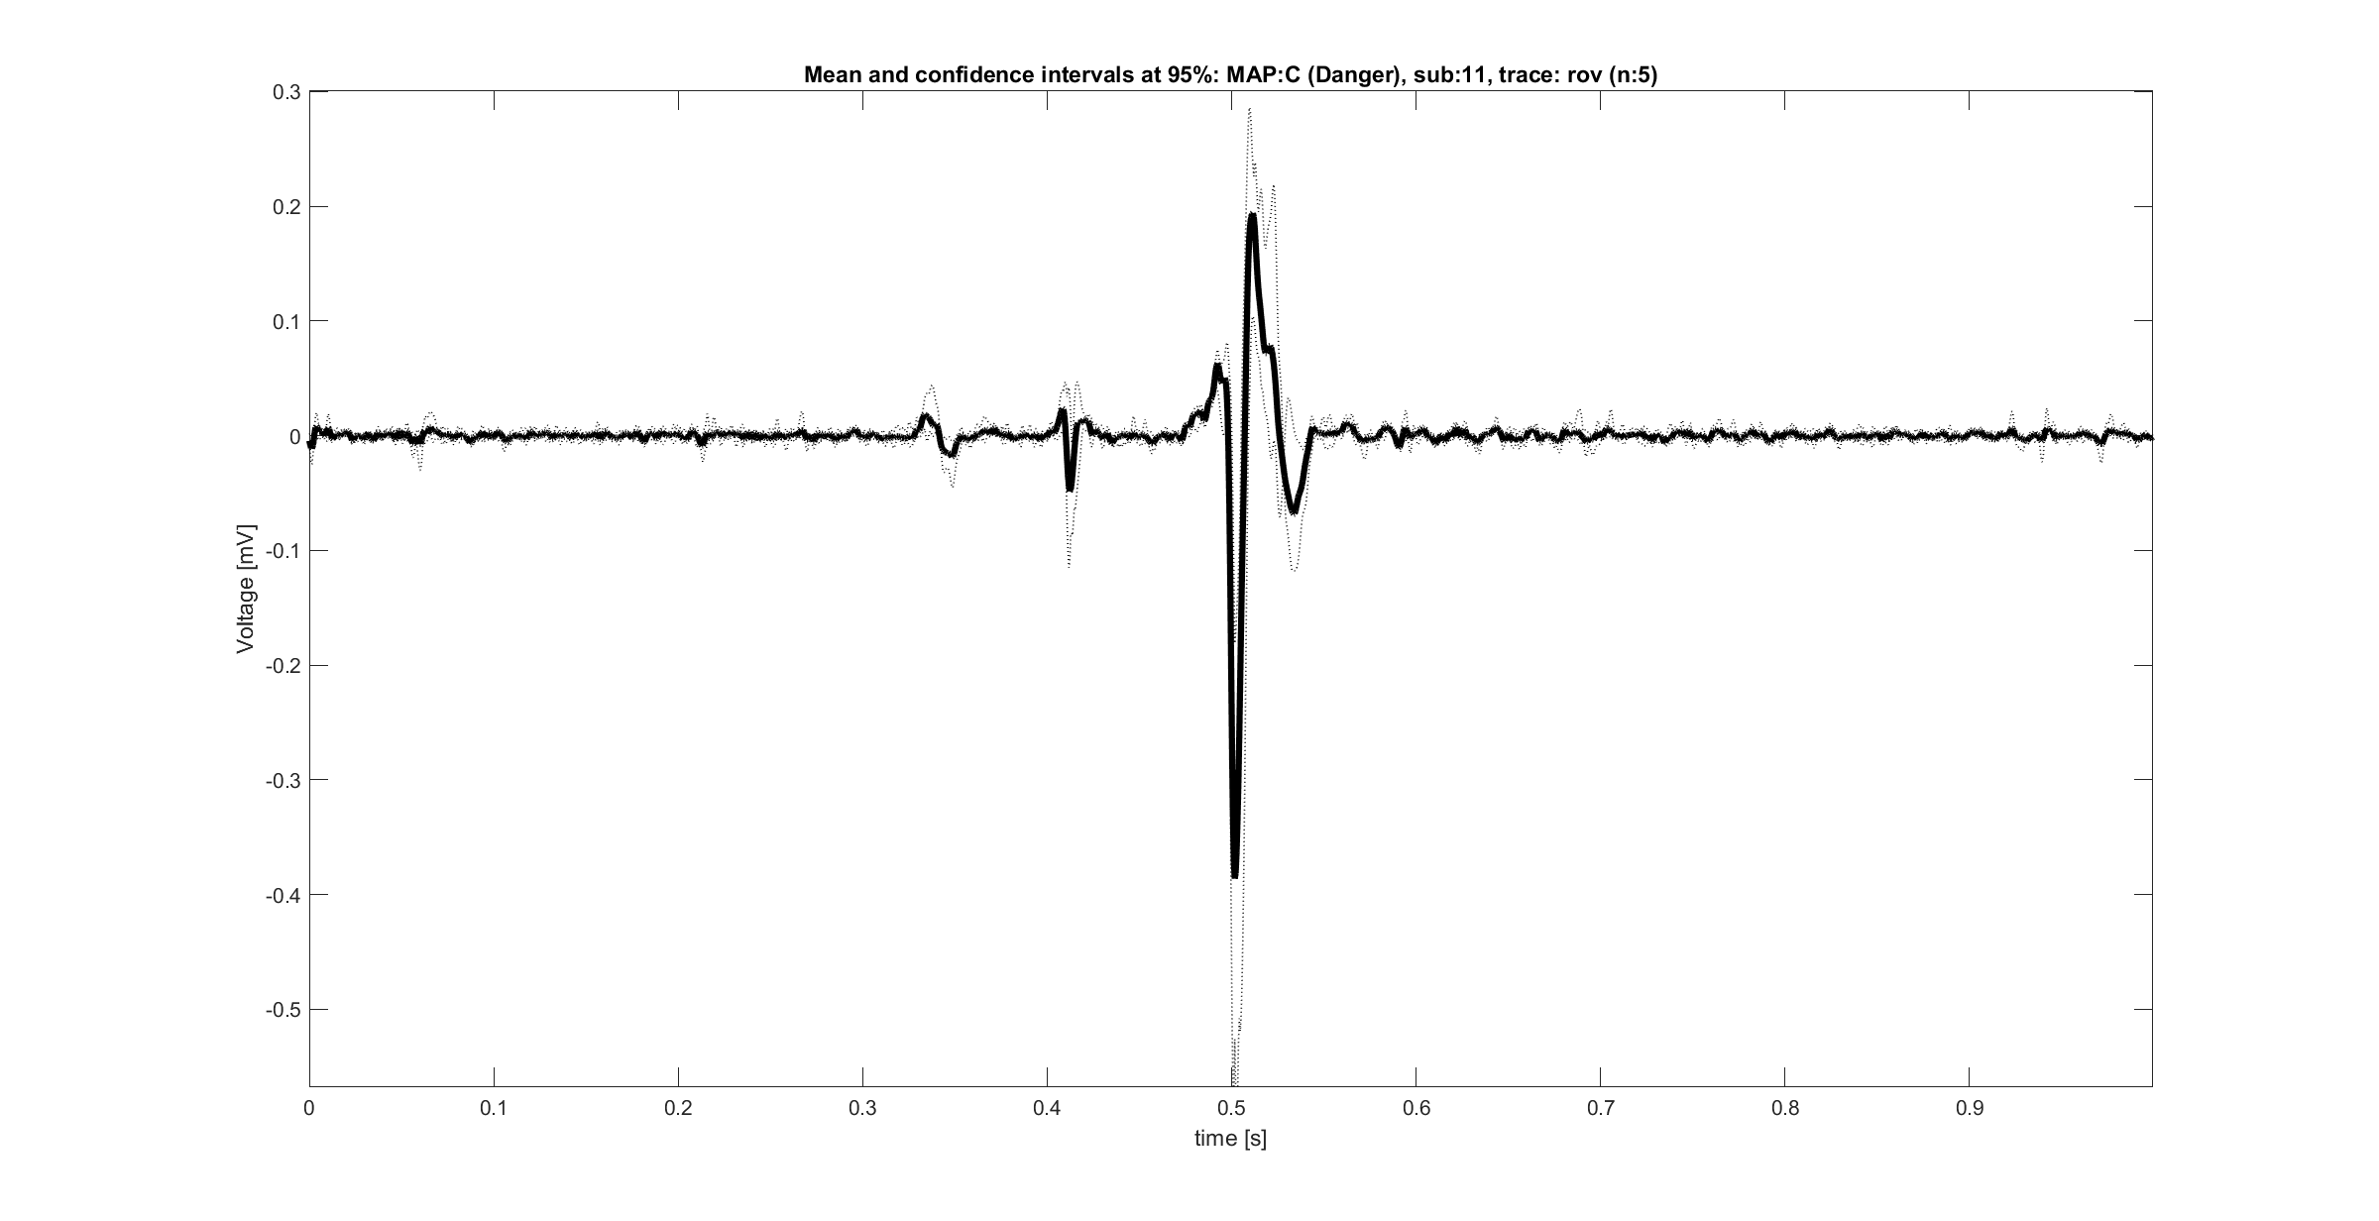
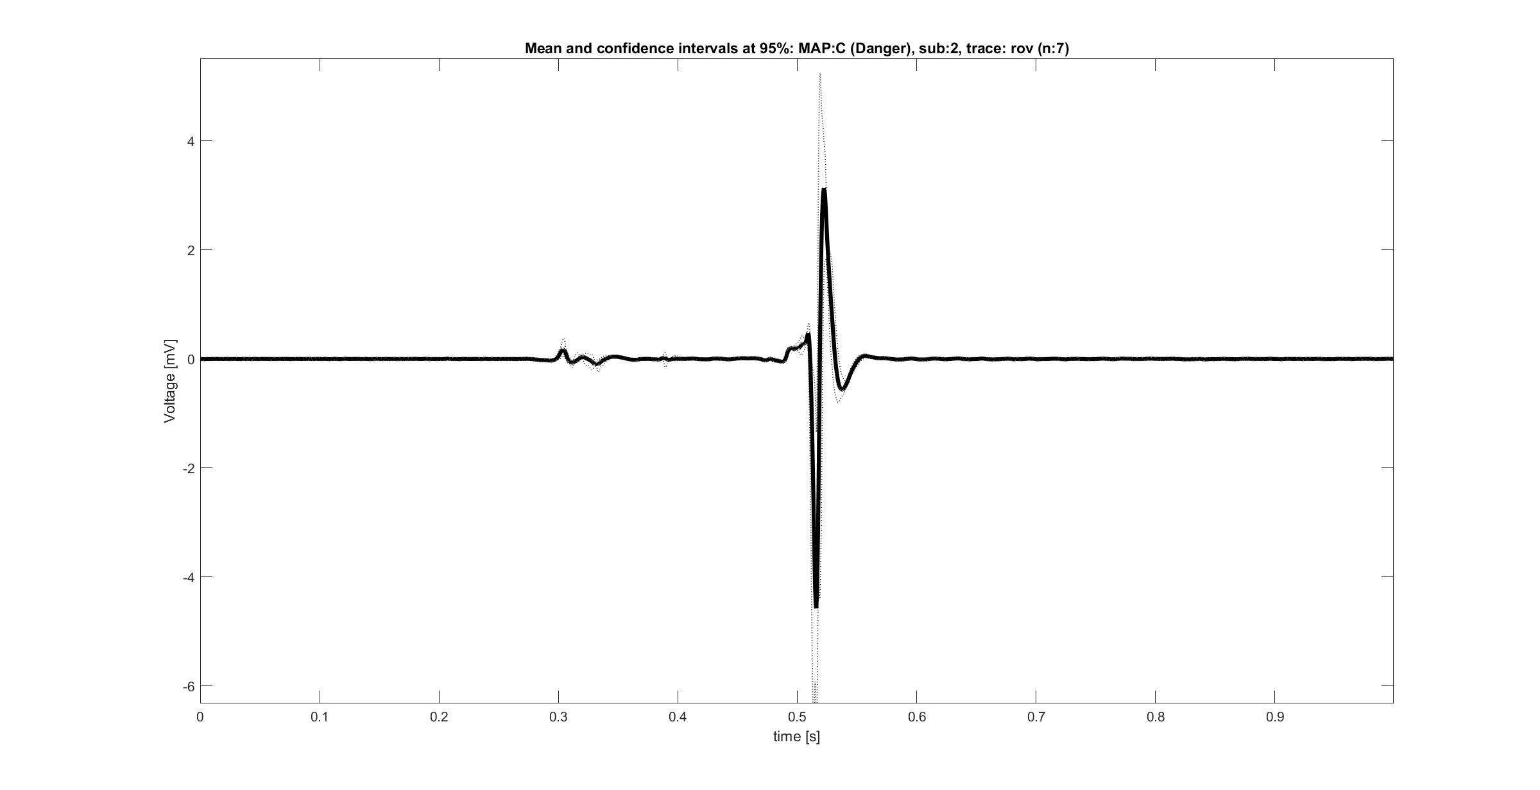
MAP C: Unexpected behaviors
Rov Trace unexpected behaviors
Not so clear and biphasic atrial signal
(TBC)Not always present 3 components
(TBC) possible presence of signals of other maps

Slide 20
Outline
Data summary and overview
Evaluations on data as population
Evaluation of a priori know characteristics of Rov trace
Comparisons between signals in time domain
Comparisons between signals in frequency domain
Results and Open questions

Slide 21
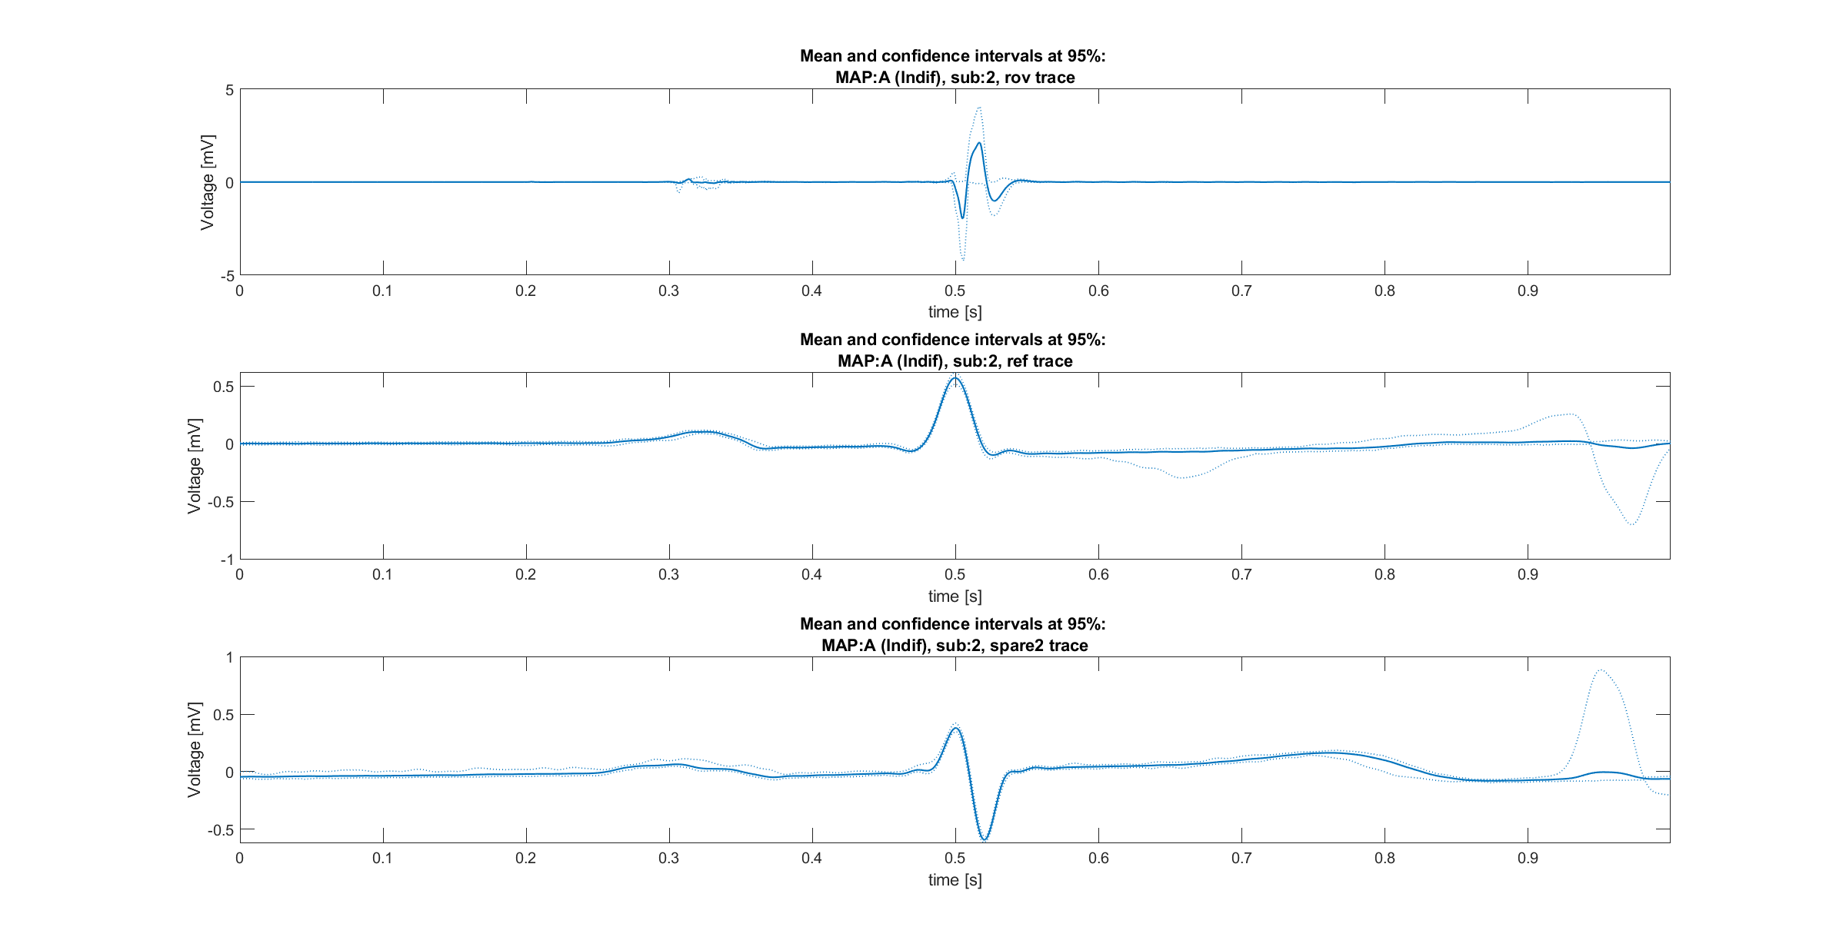
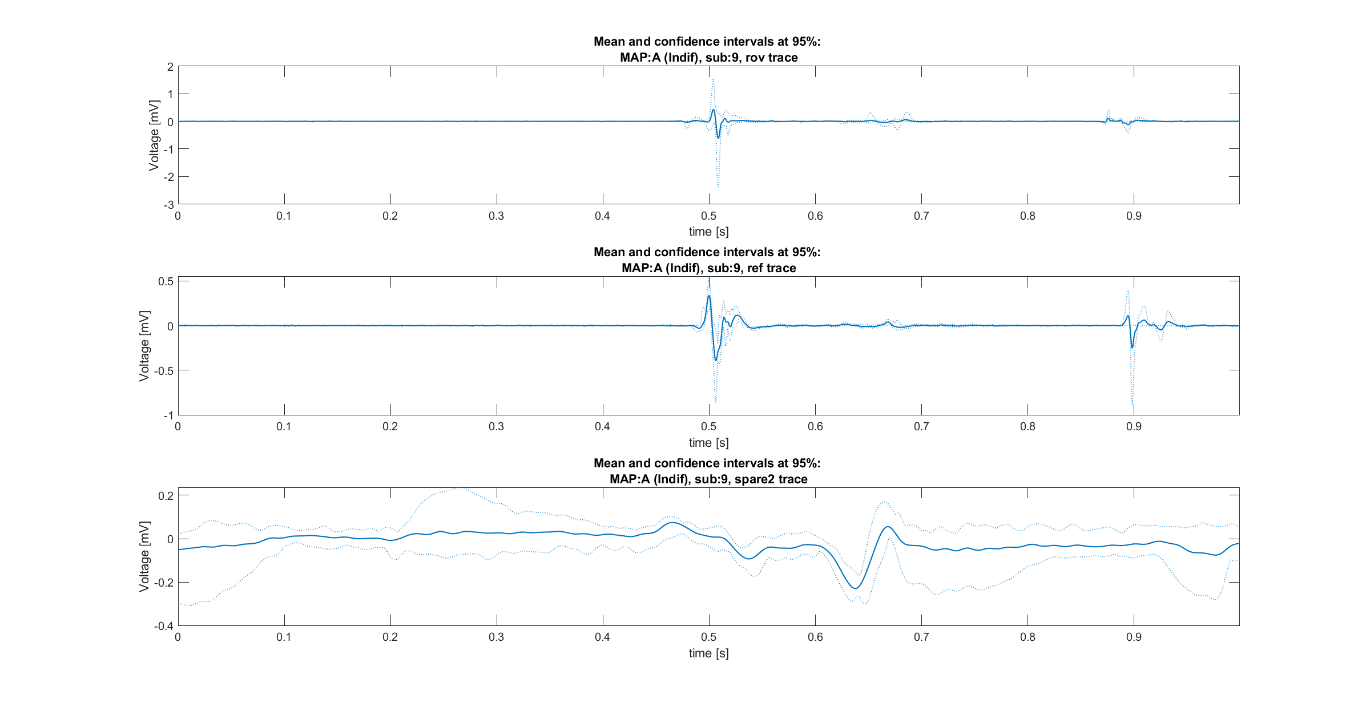
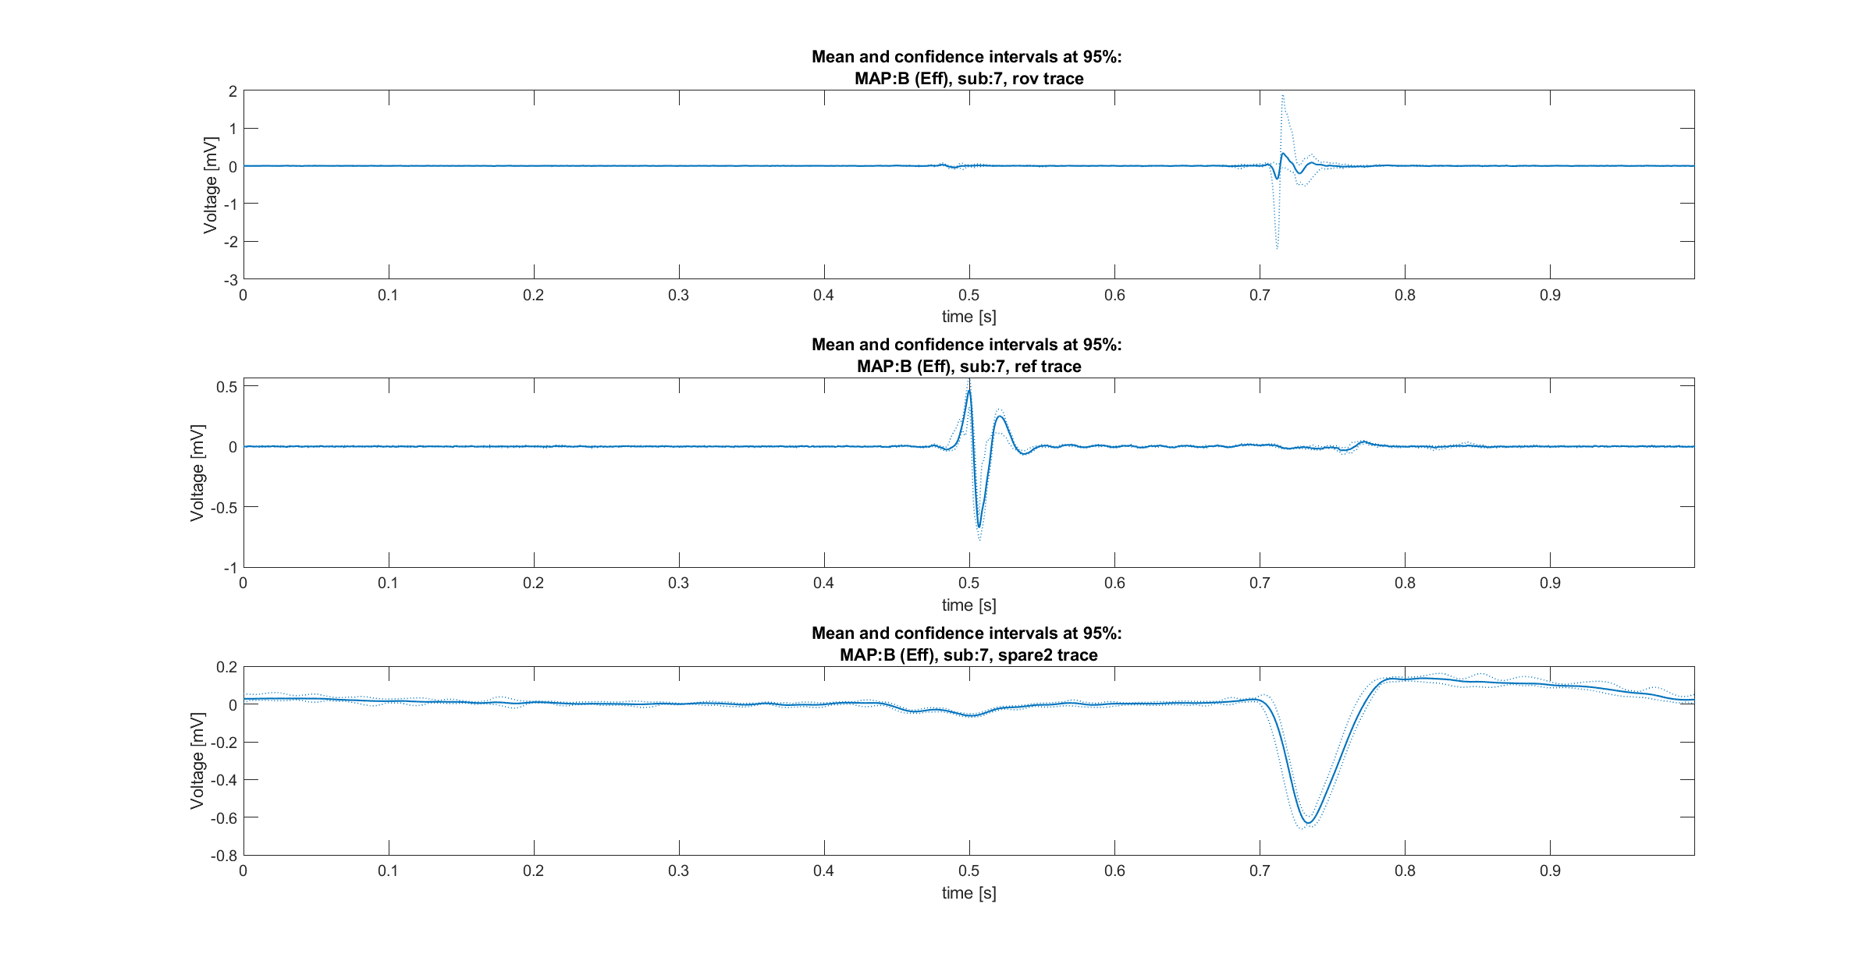
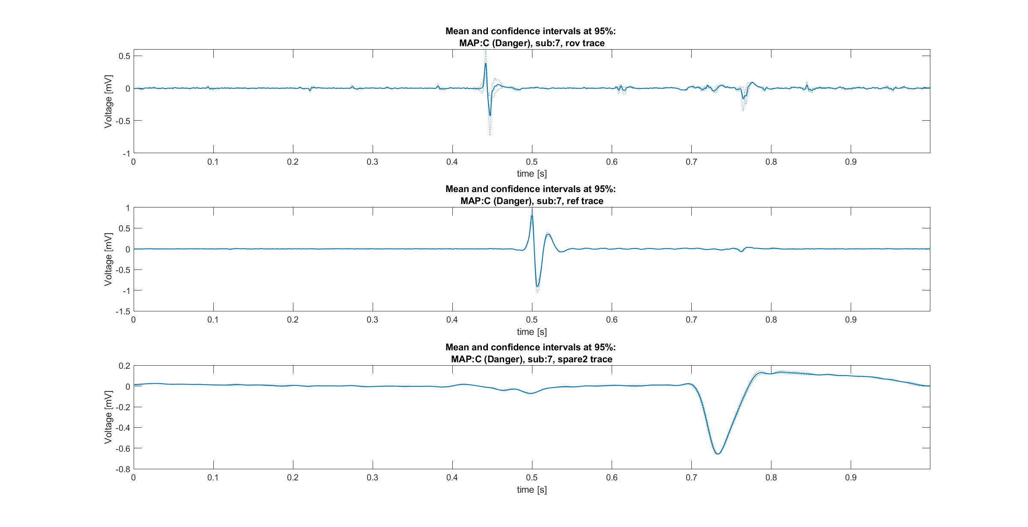
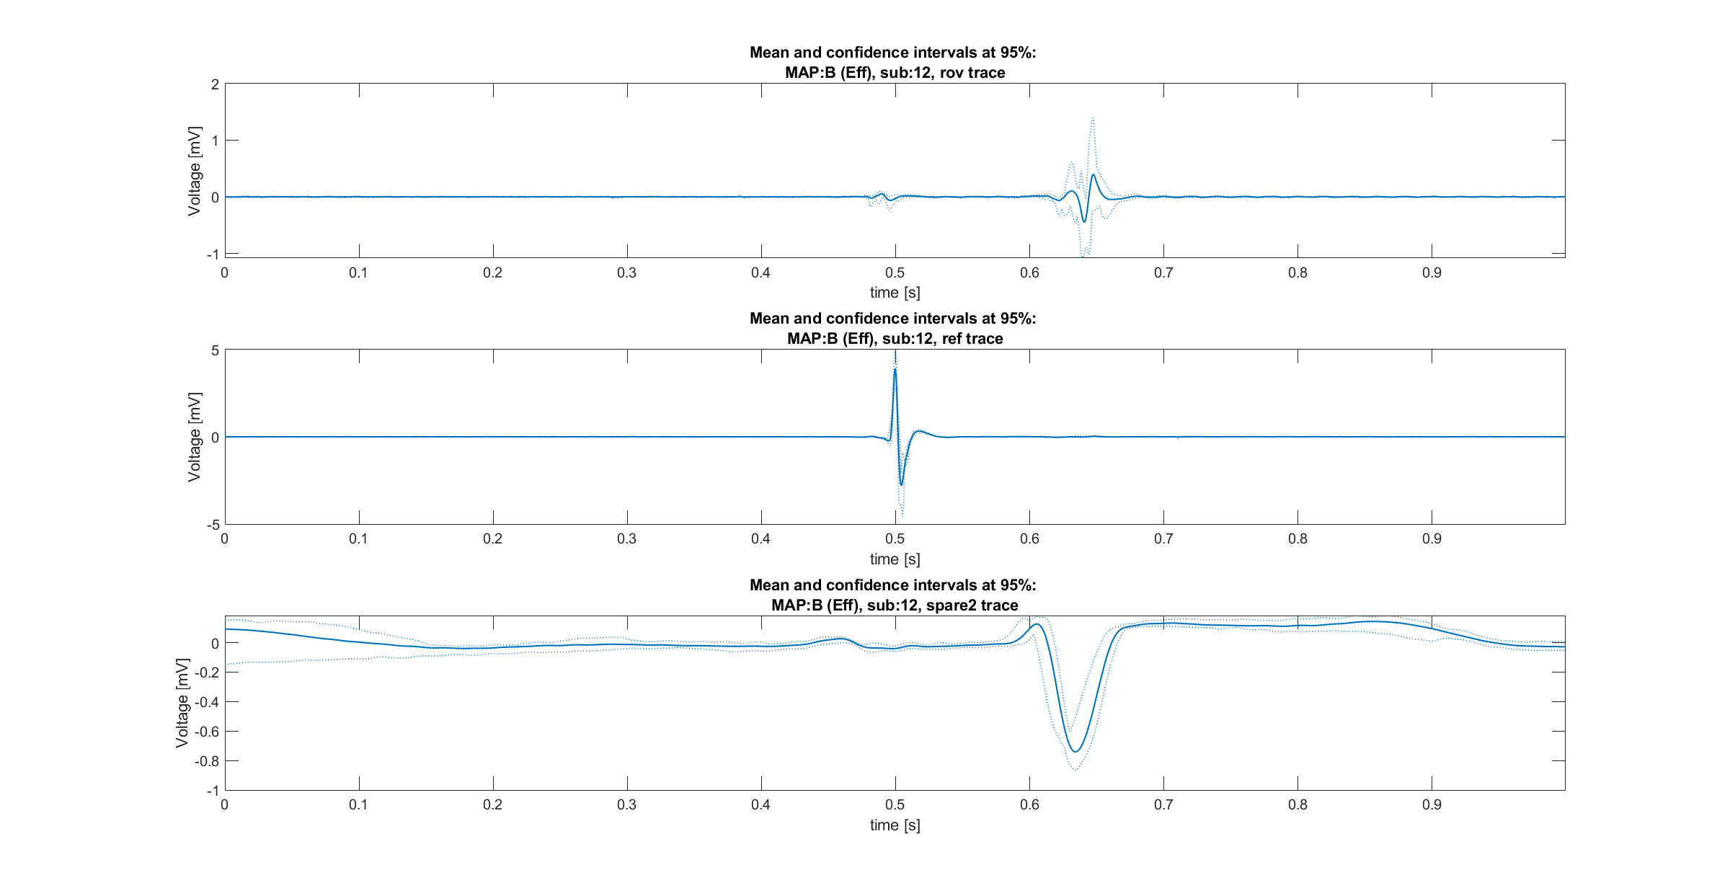
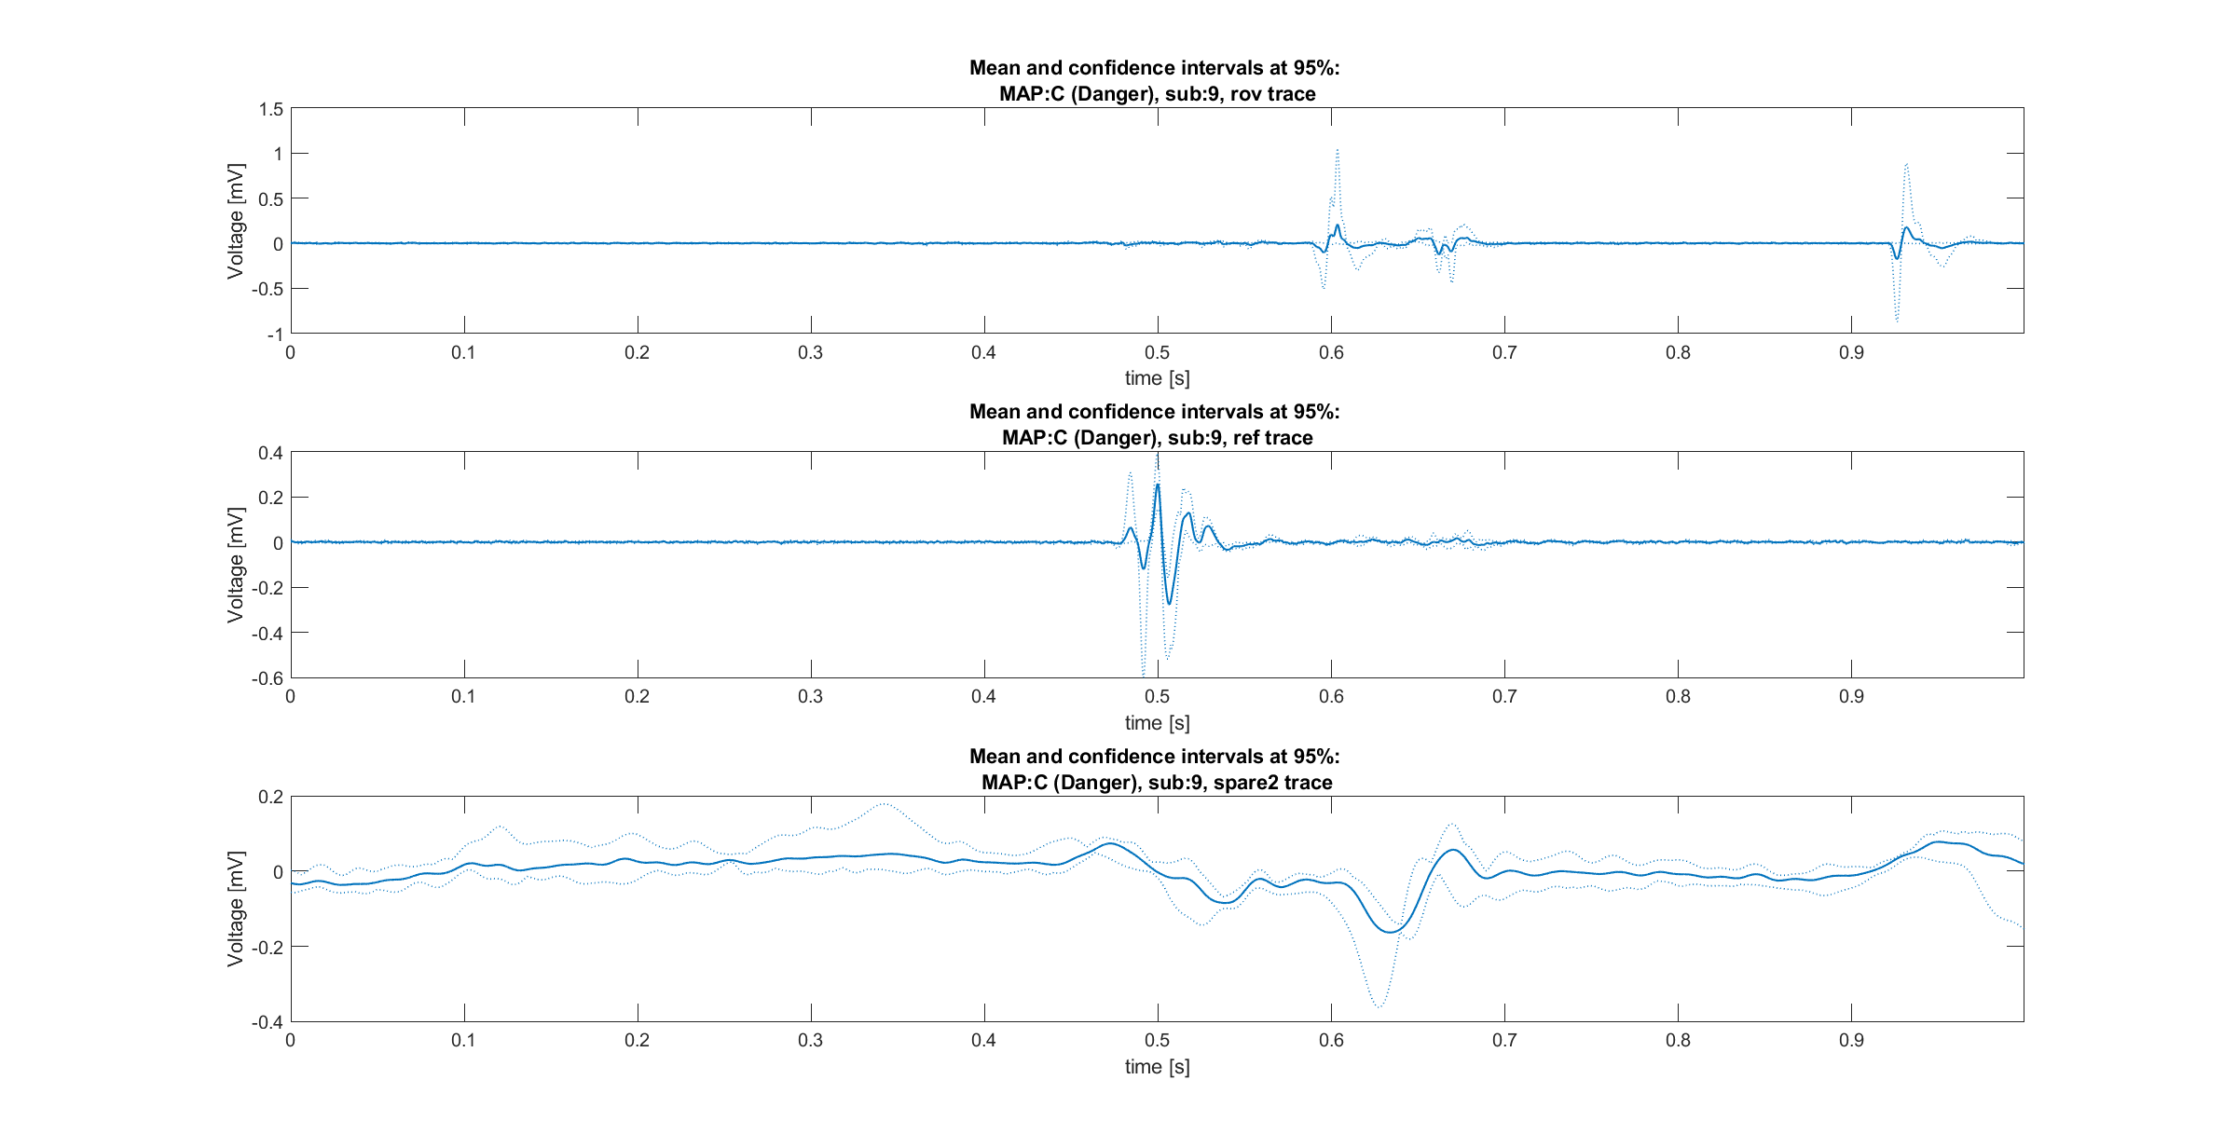
Comparisons between signals [1/3]
Comparisons between (mean) signals of different subjects
Map A example
Map C example
Map B example
In general, clear difference of amplitude between signals
Expected behaviors of Rov trace confirmed between maps, at least in most cases.
Differences into the alignment of the peaks, even between signals of the same subject.
Should these signals be aligned respect to the P wave?

Slide 22
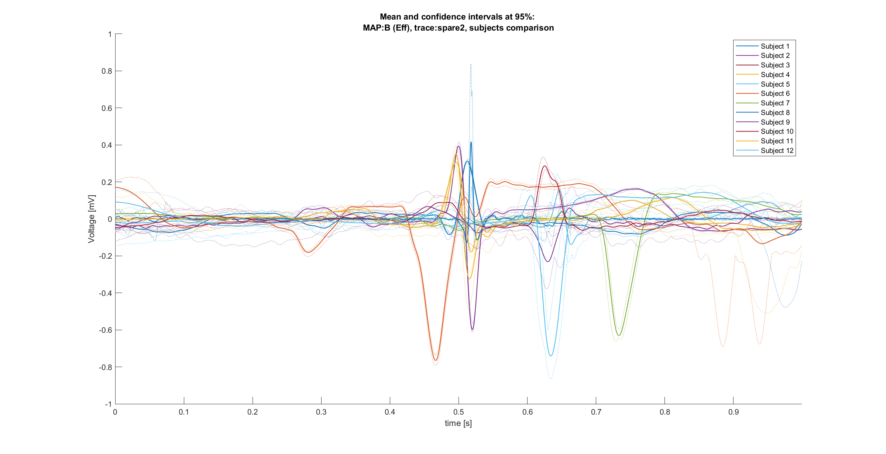
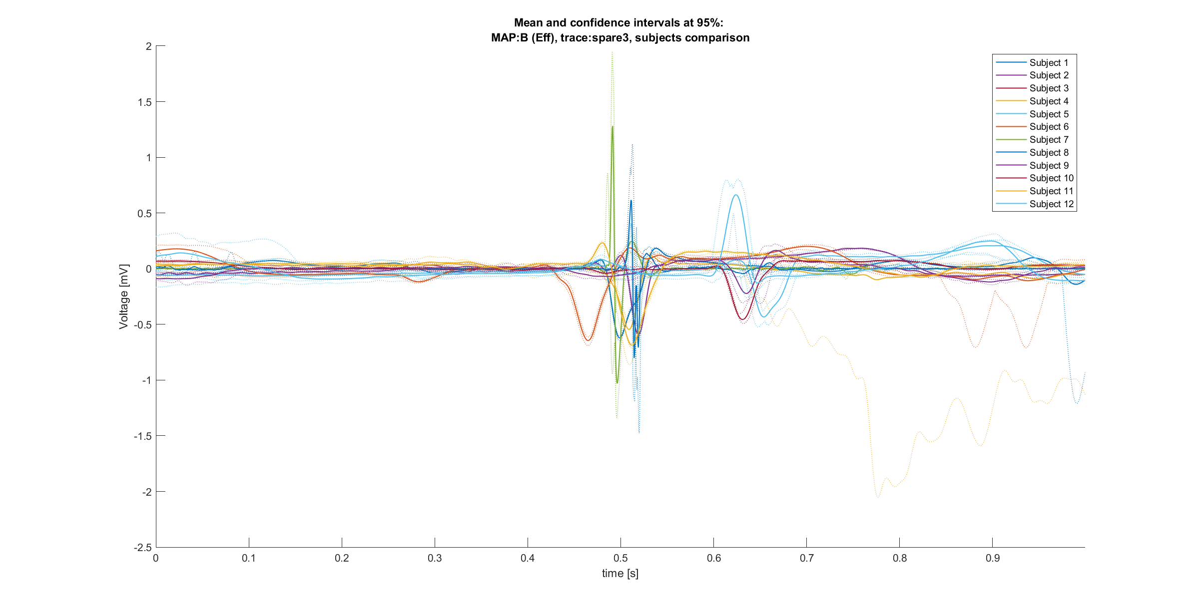
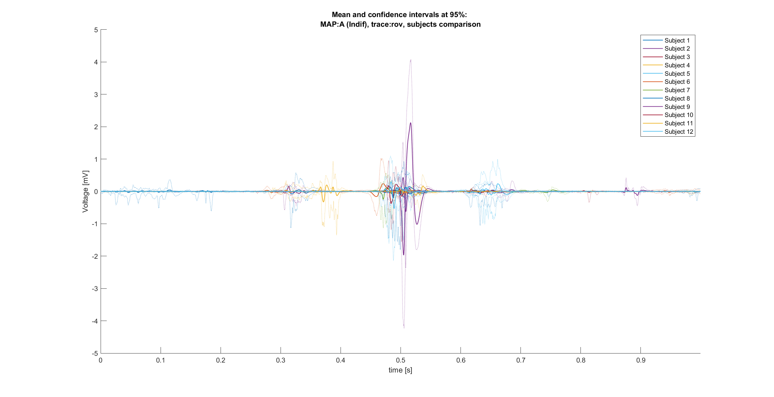
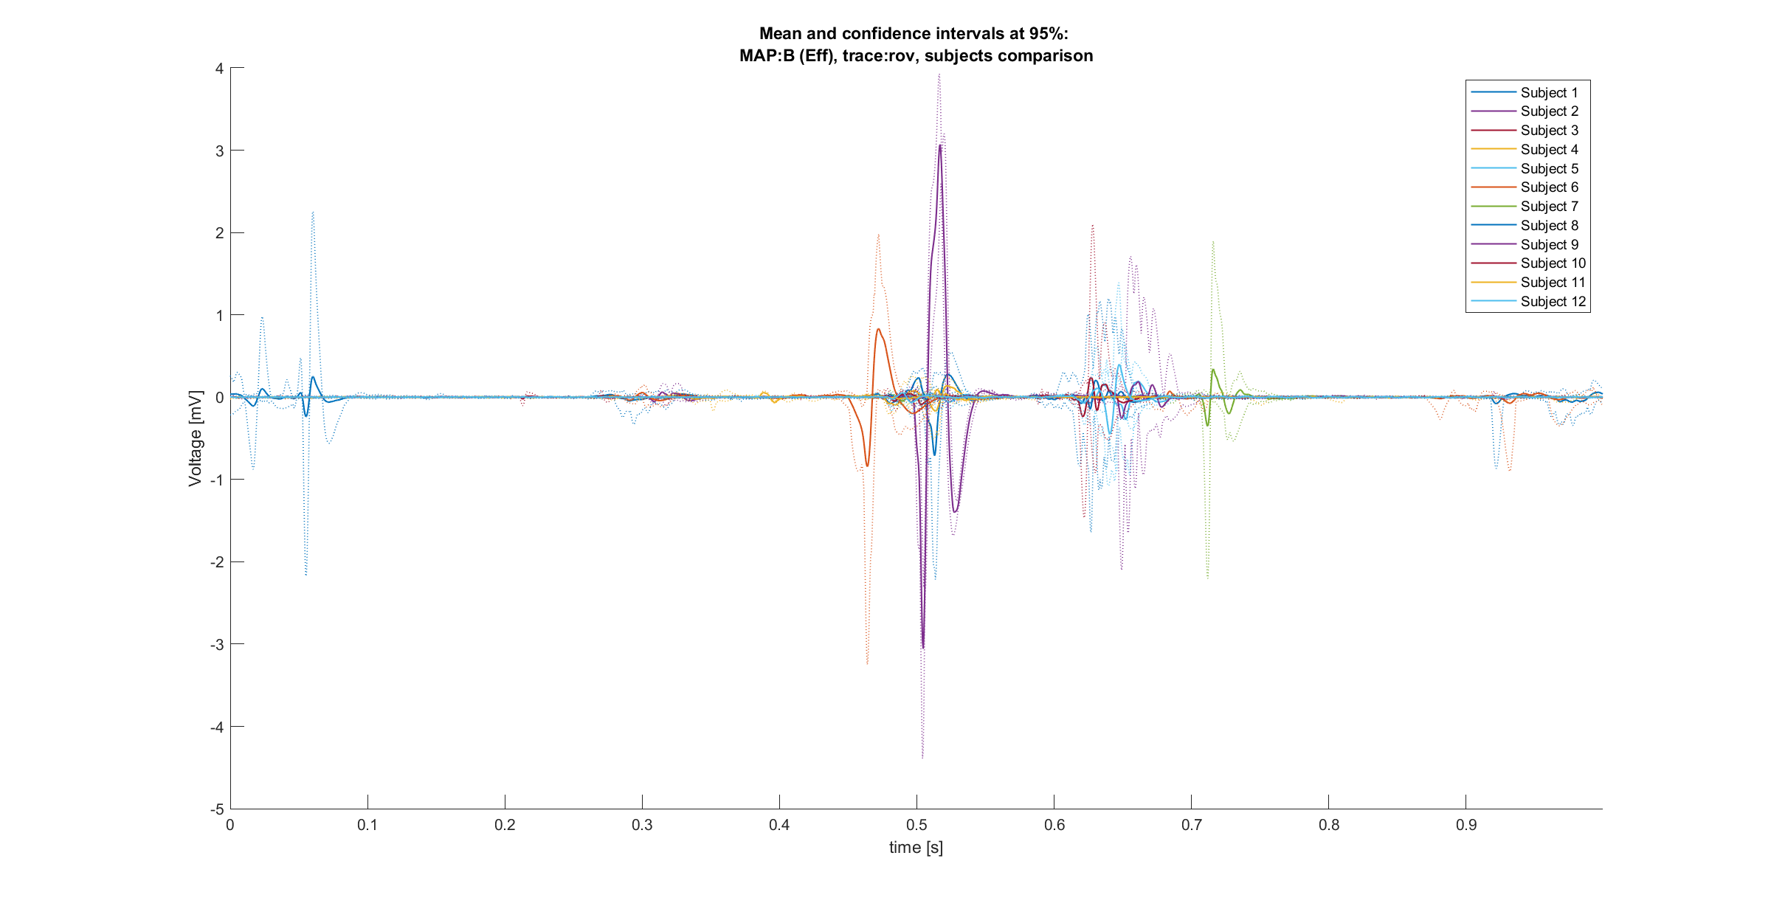
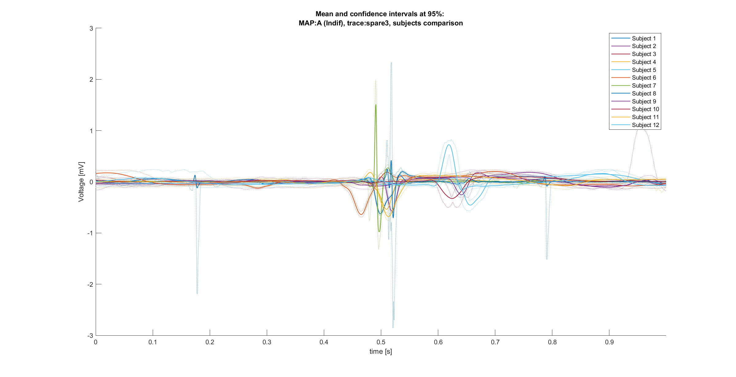
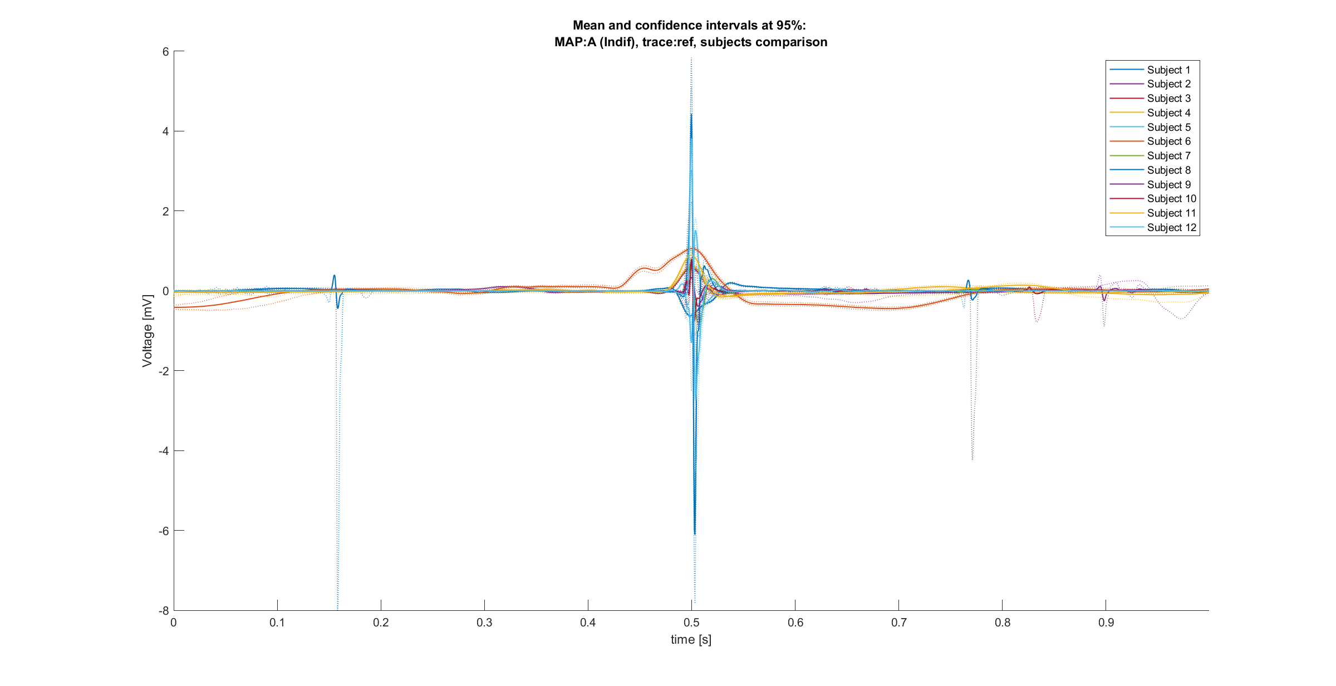
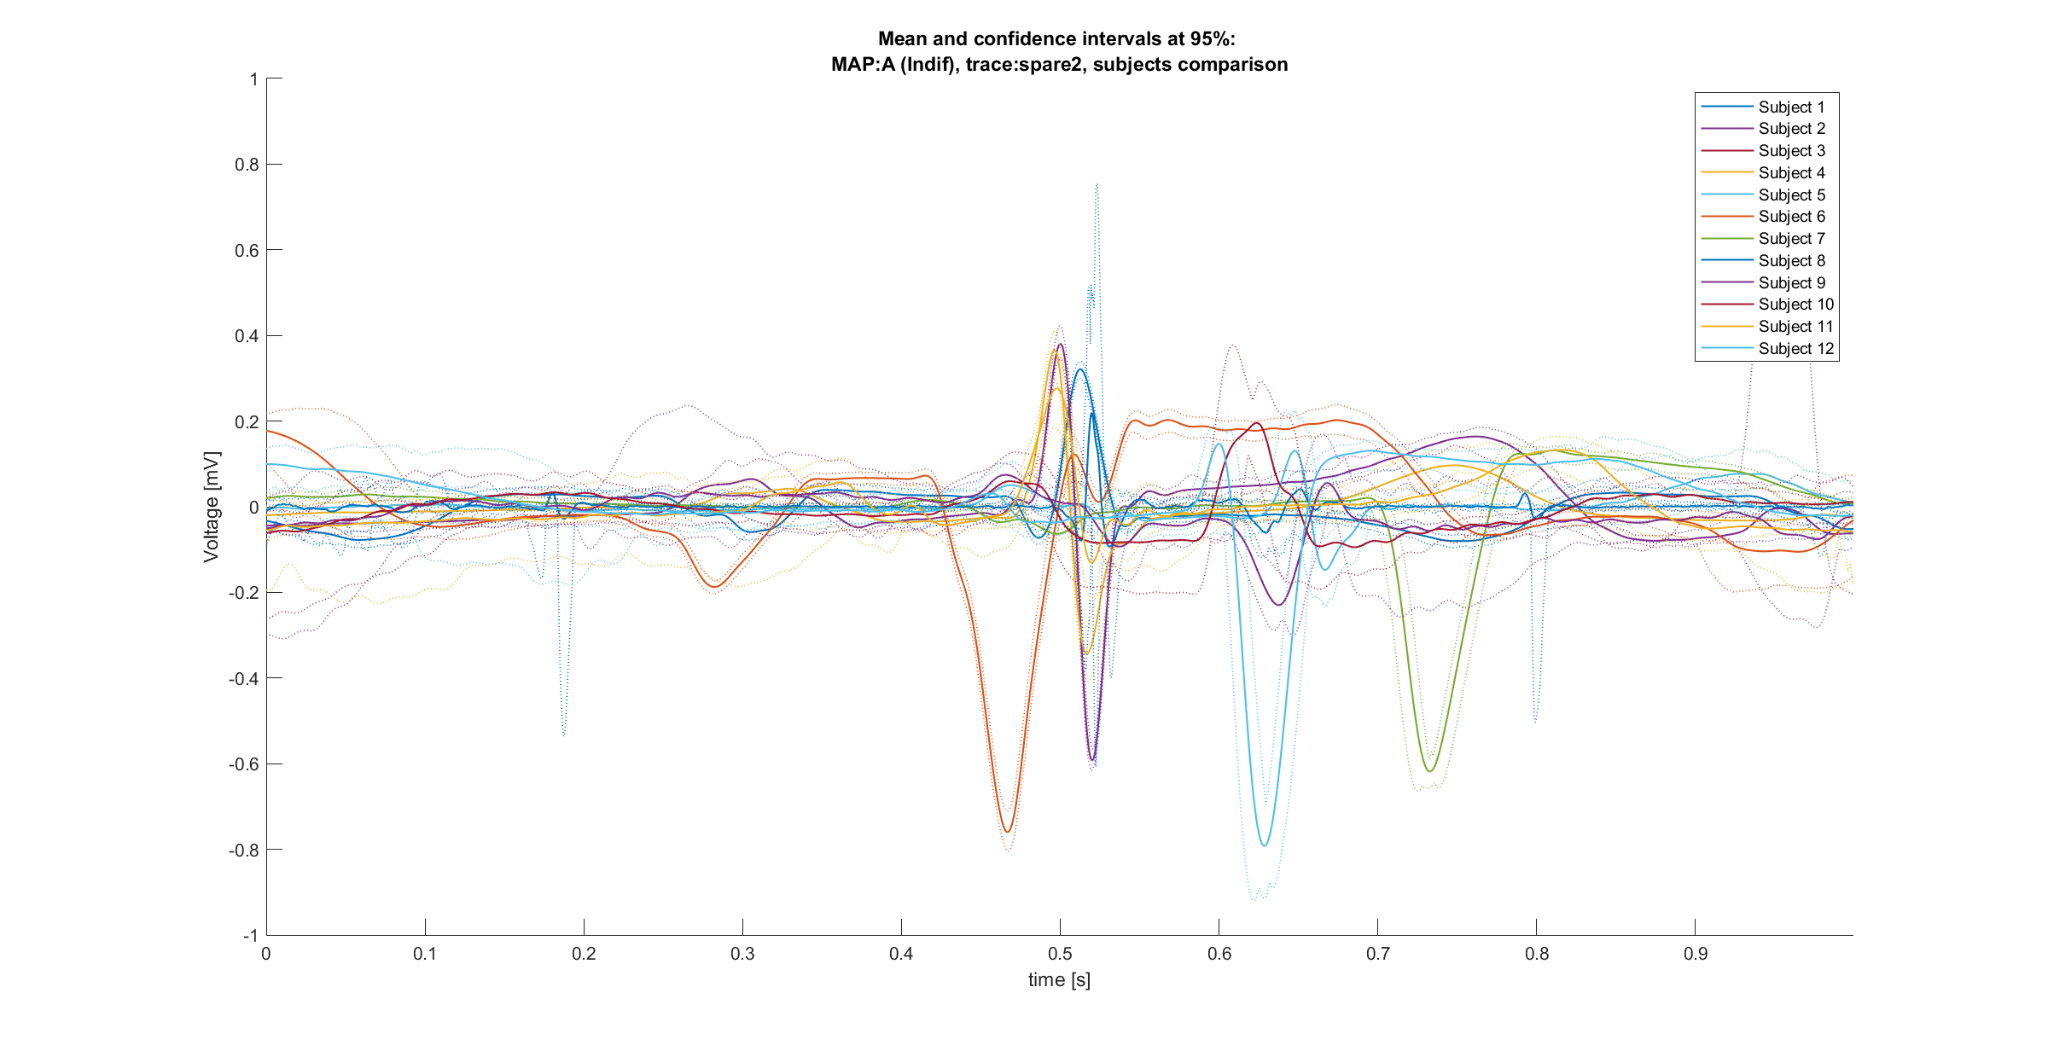
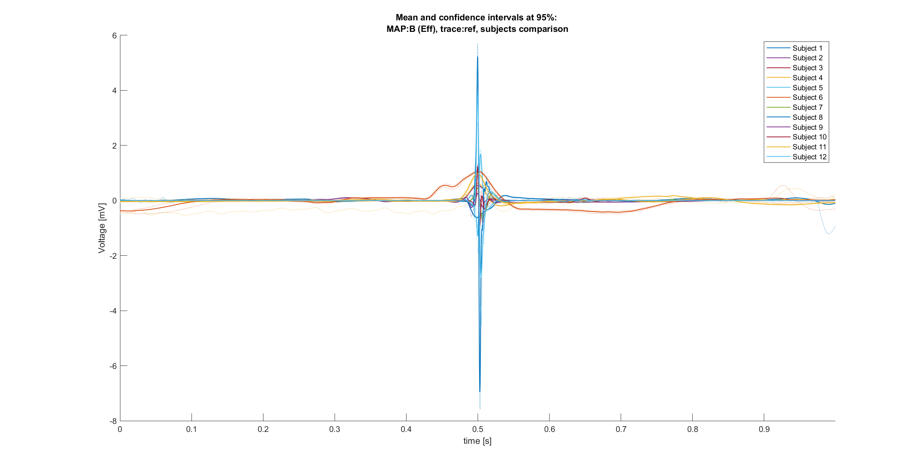
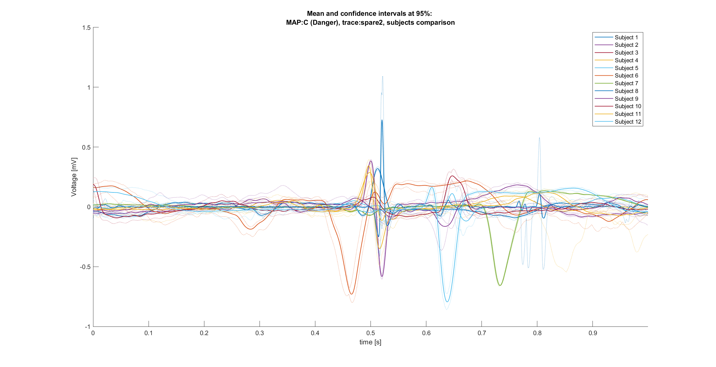
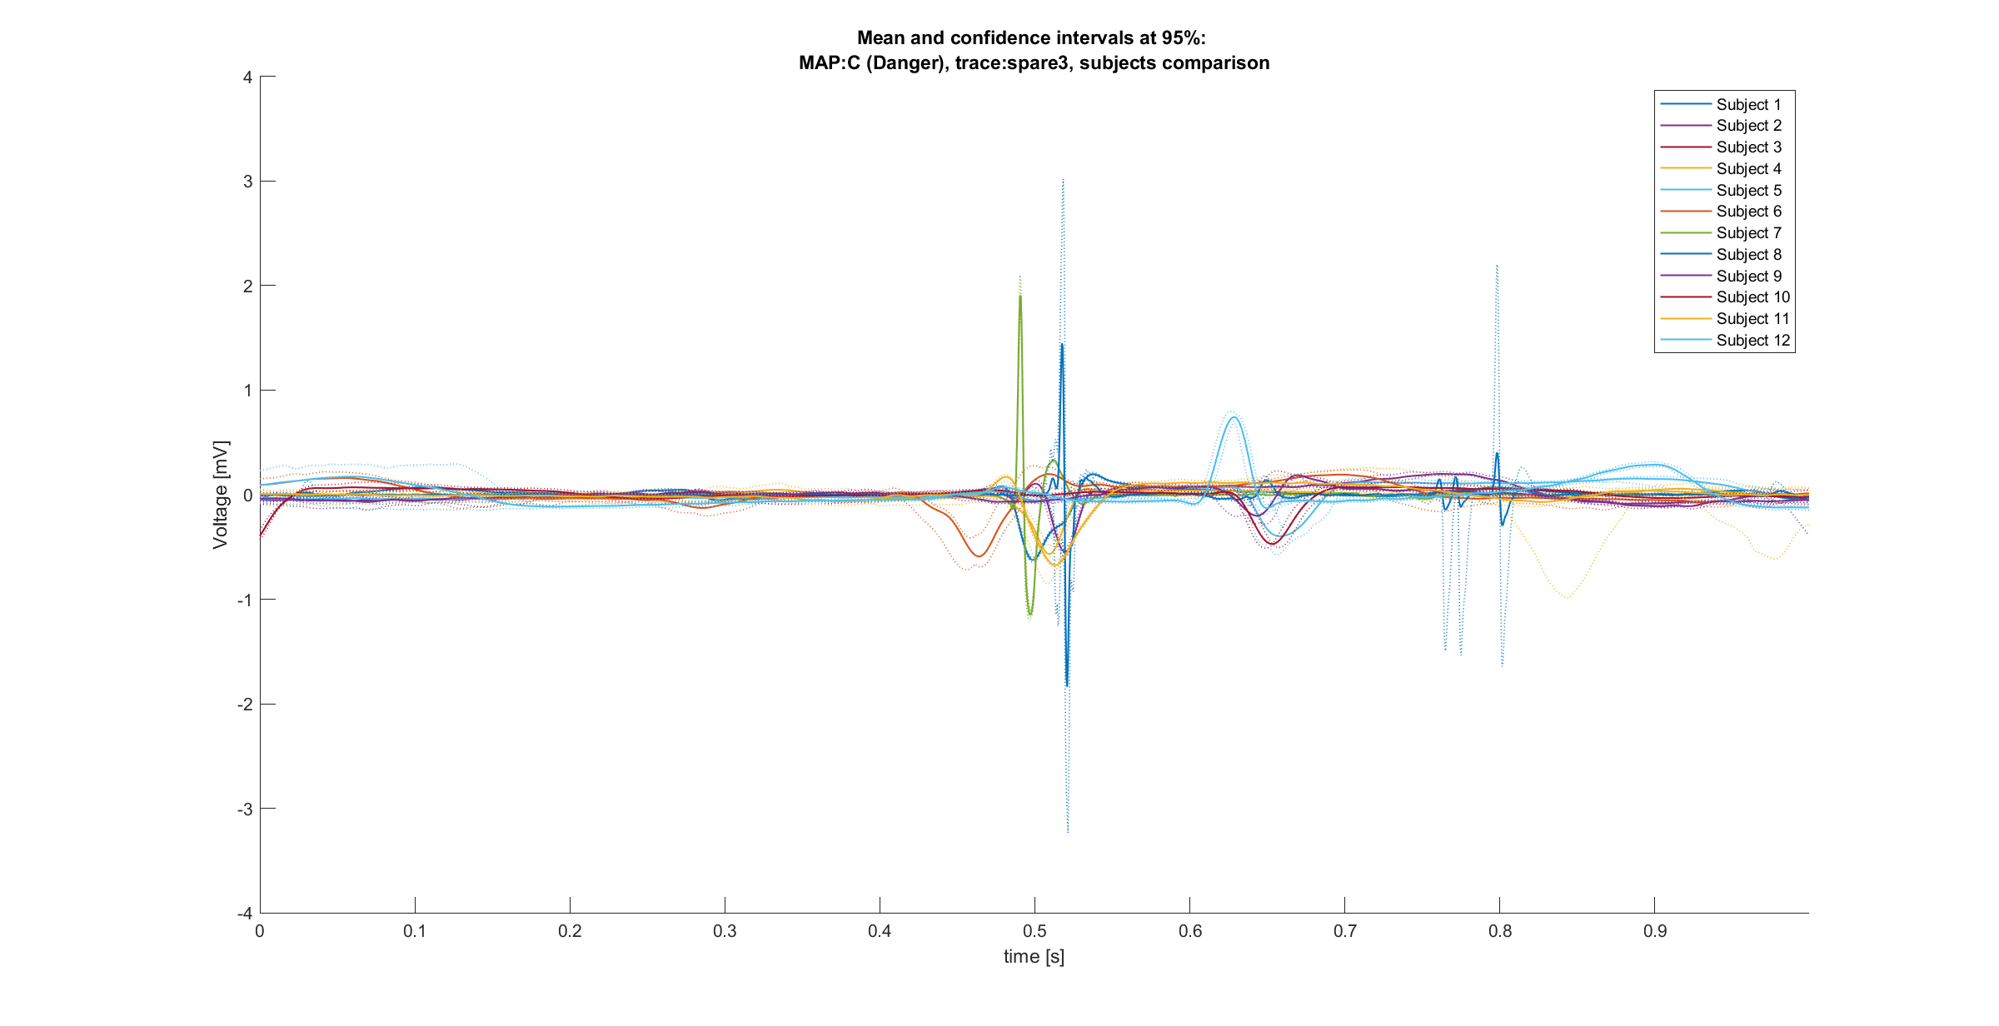
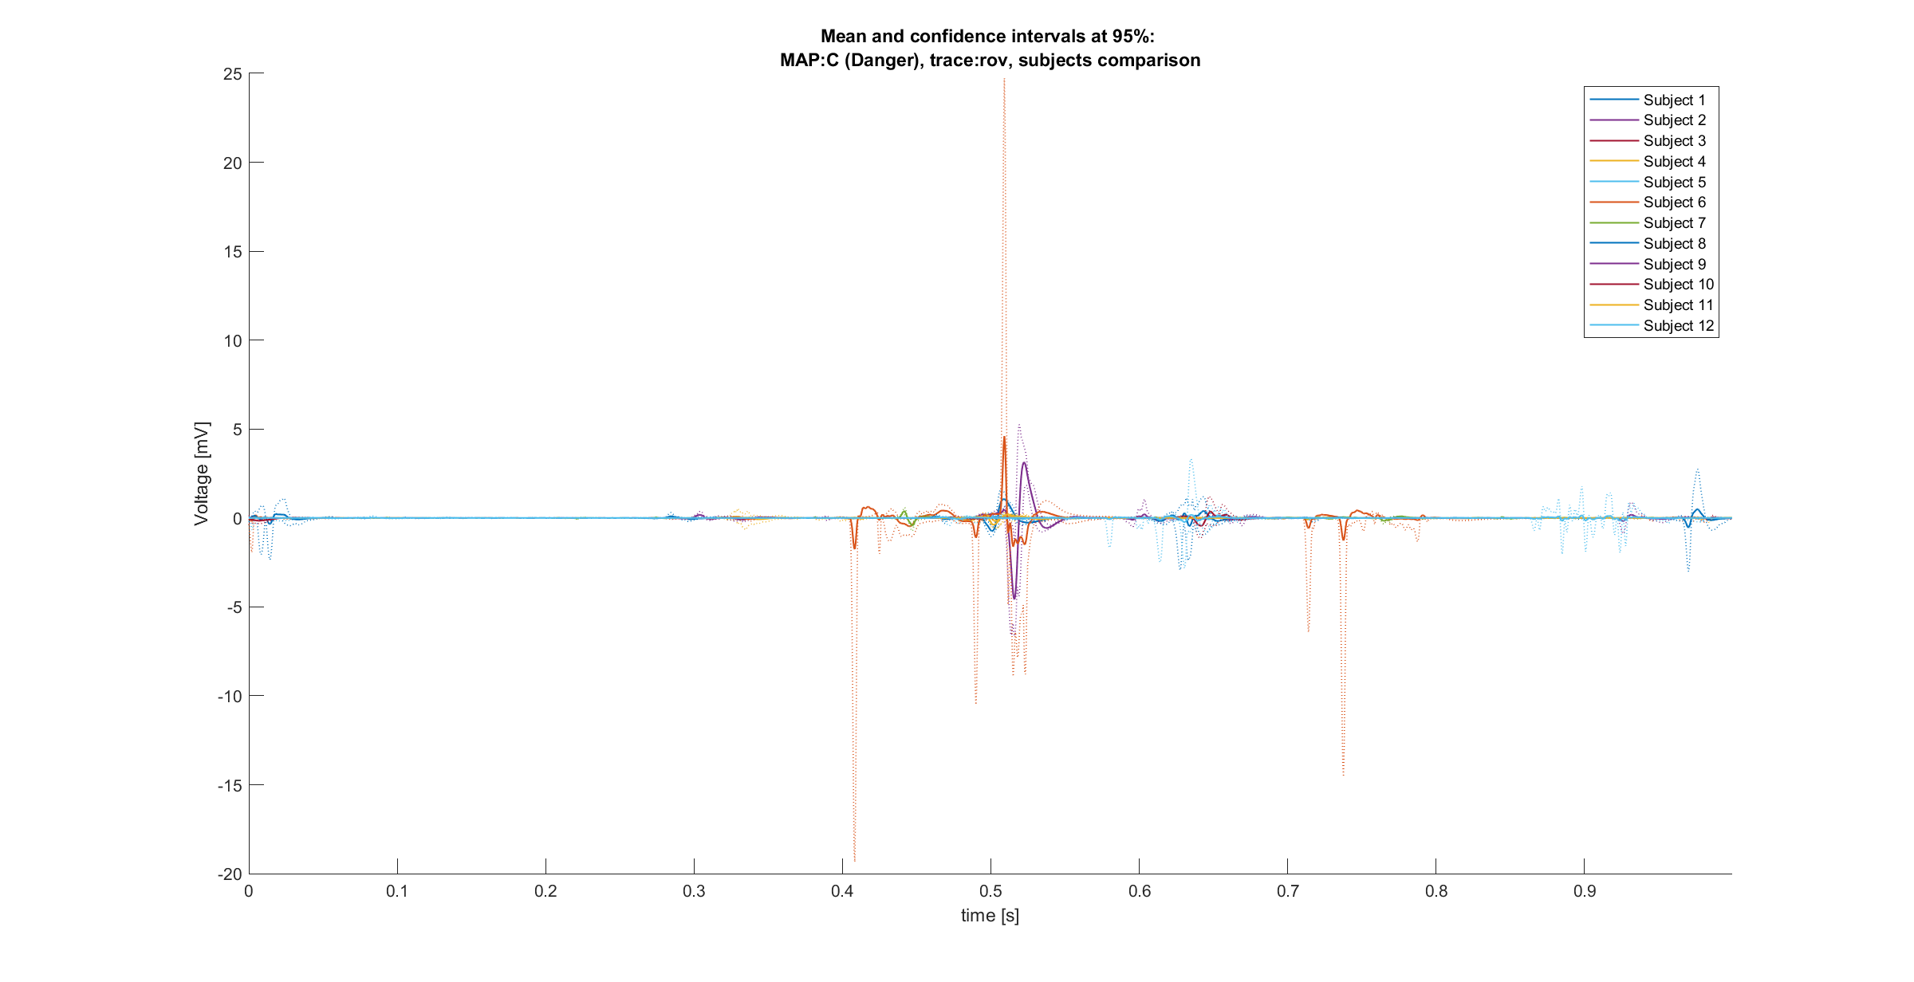
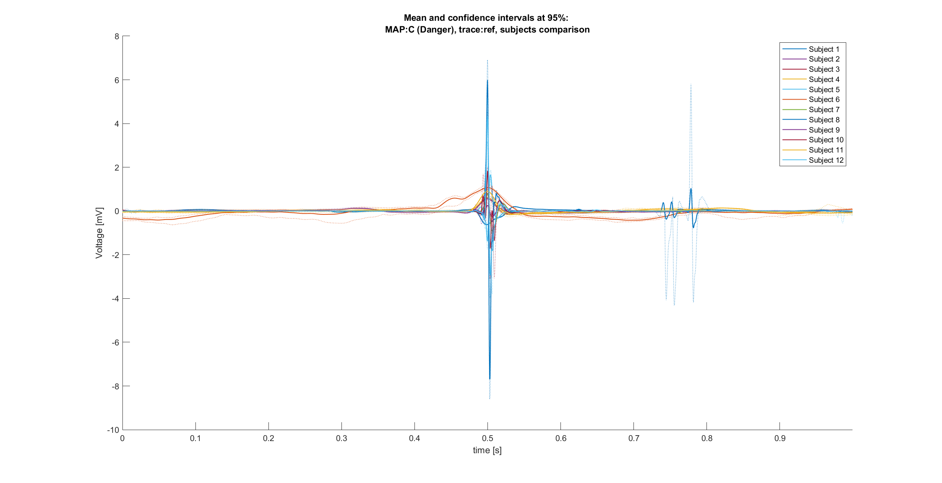
Comparisons between signals [2/3]
Map B, spare3 trace
Map B, spare2 trace
Map A, spare3 trace
Map B, Ref trace
Map A, spare2 trace
Subject signals variability
Map A, Ref trace
Map B, Rov trace
Map A, Rov trace
Rov trace:
in general, maps behaviors confirmed
High variability in amplitude of signals
(TBC) Alignment issues
Ref/spare 1 trace:
Minor differences between maps, most relevant related to the expected components of the signals
Spare 2 trace:
Minor differences between maps Signals are in general less clear and interpretable.
Spare 3 trace:
Minor differences between maps. Signals clearer and more interpretable.
Map C, spare2 trace
Map C, spare3 trace
Map C, Ref trace
Map C, Rov trace

Slide 23
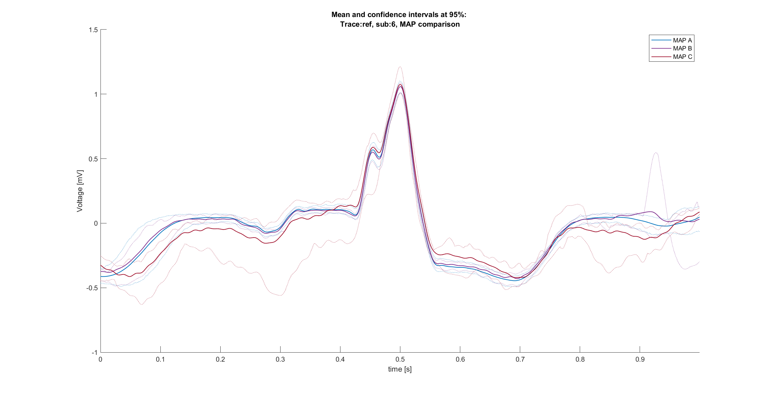
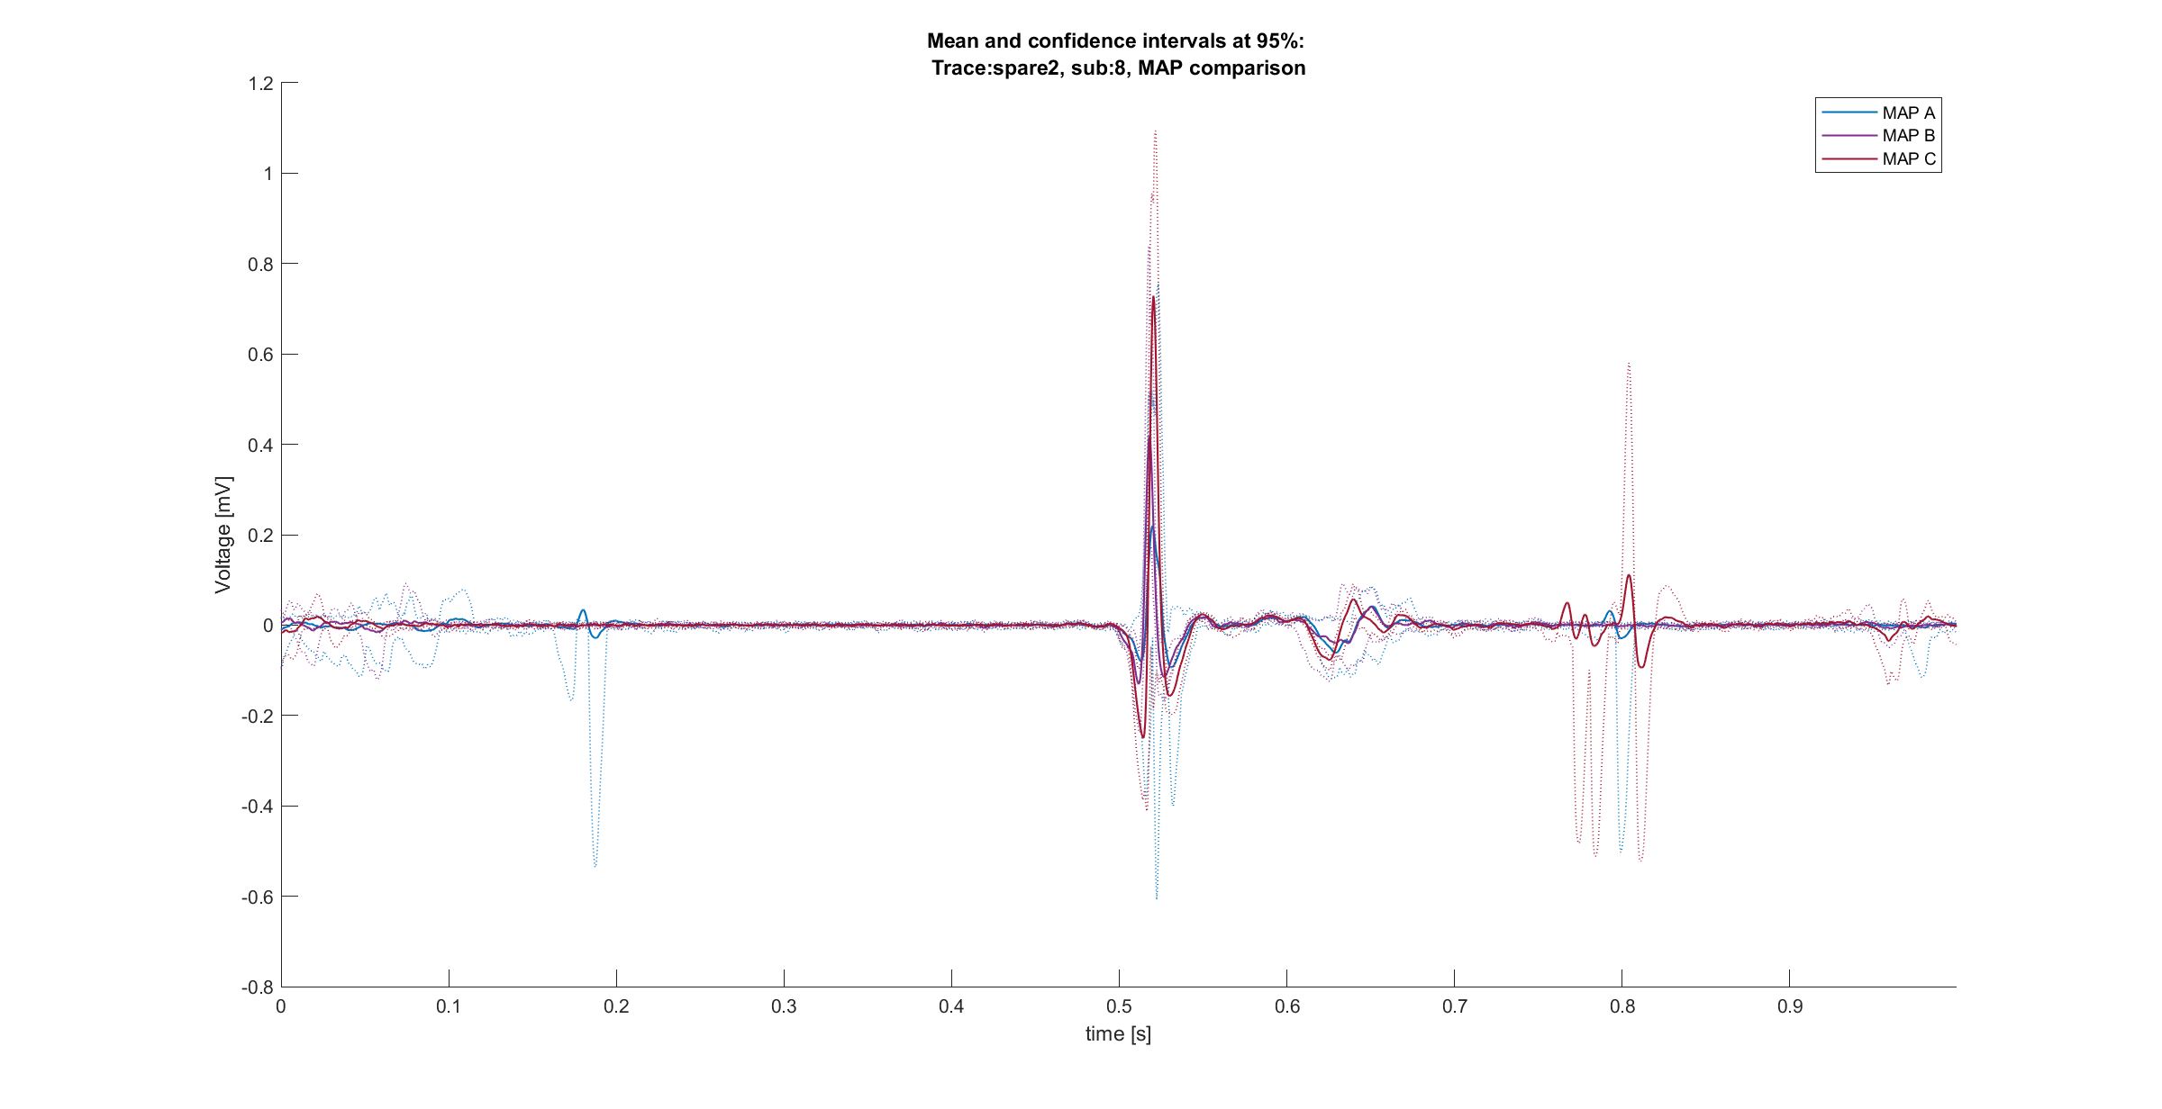
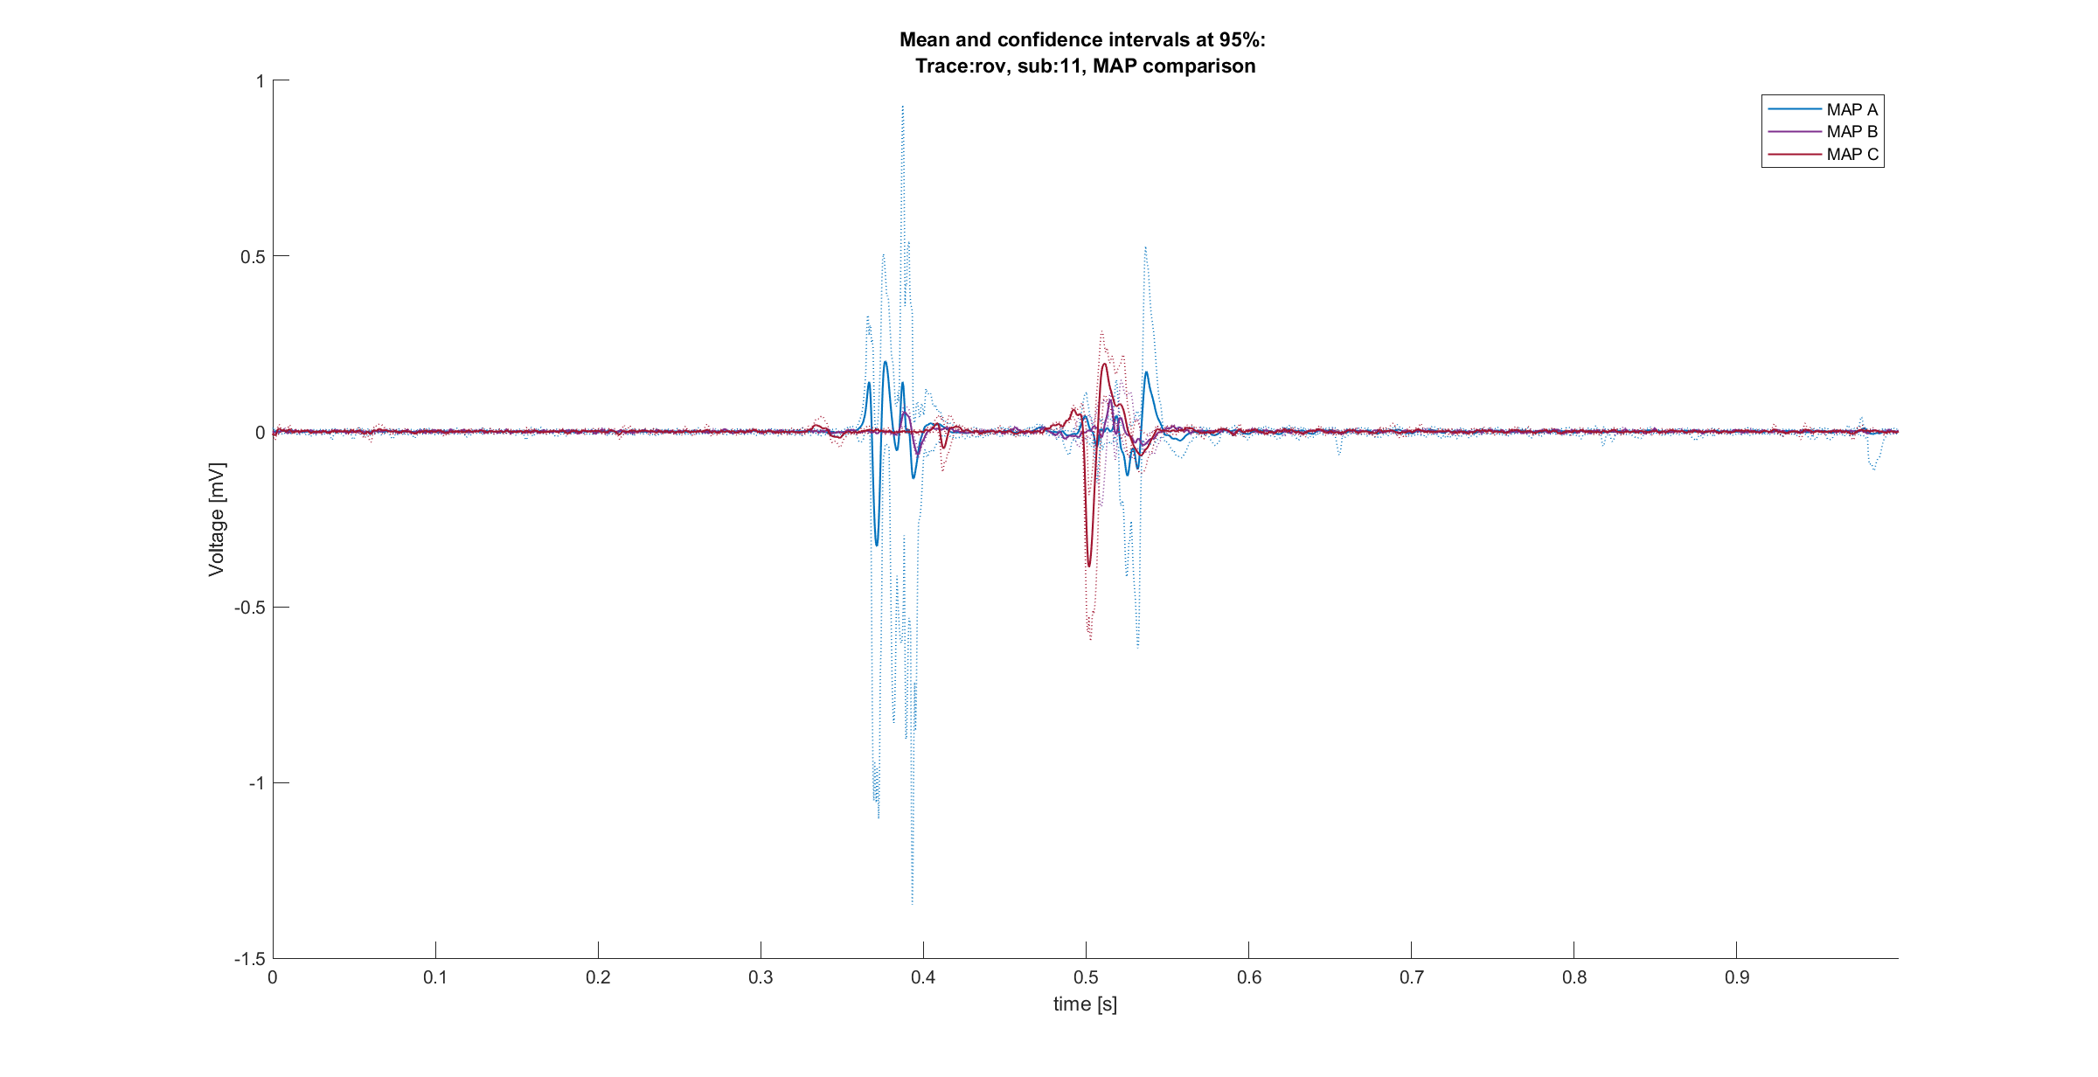
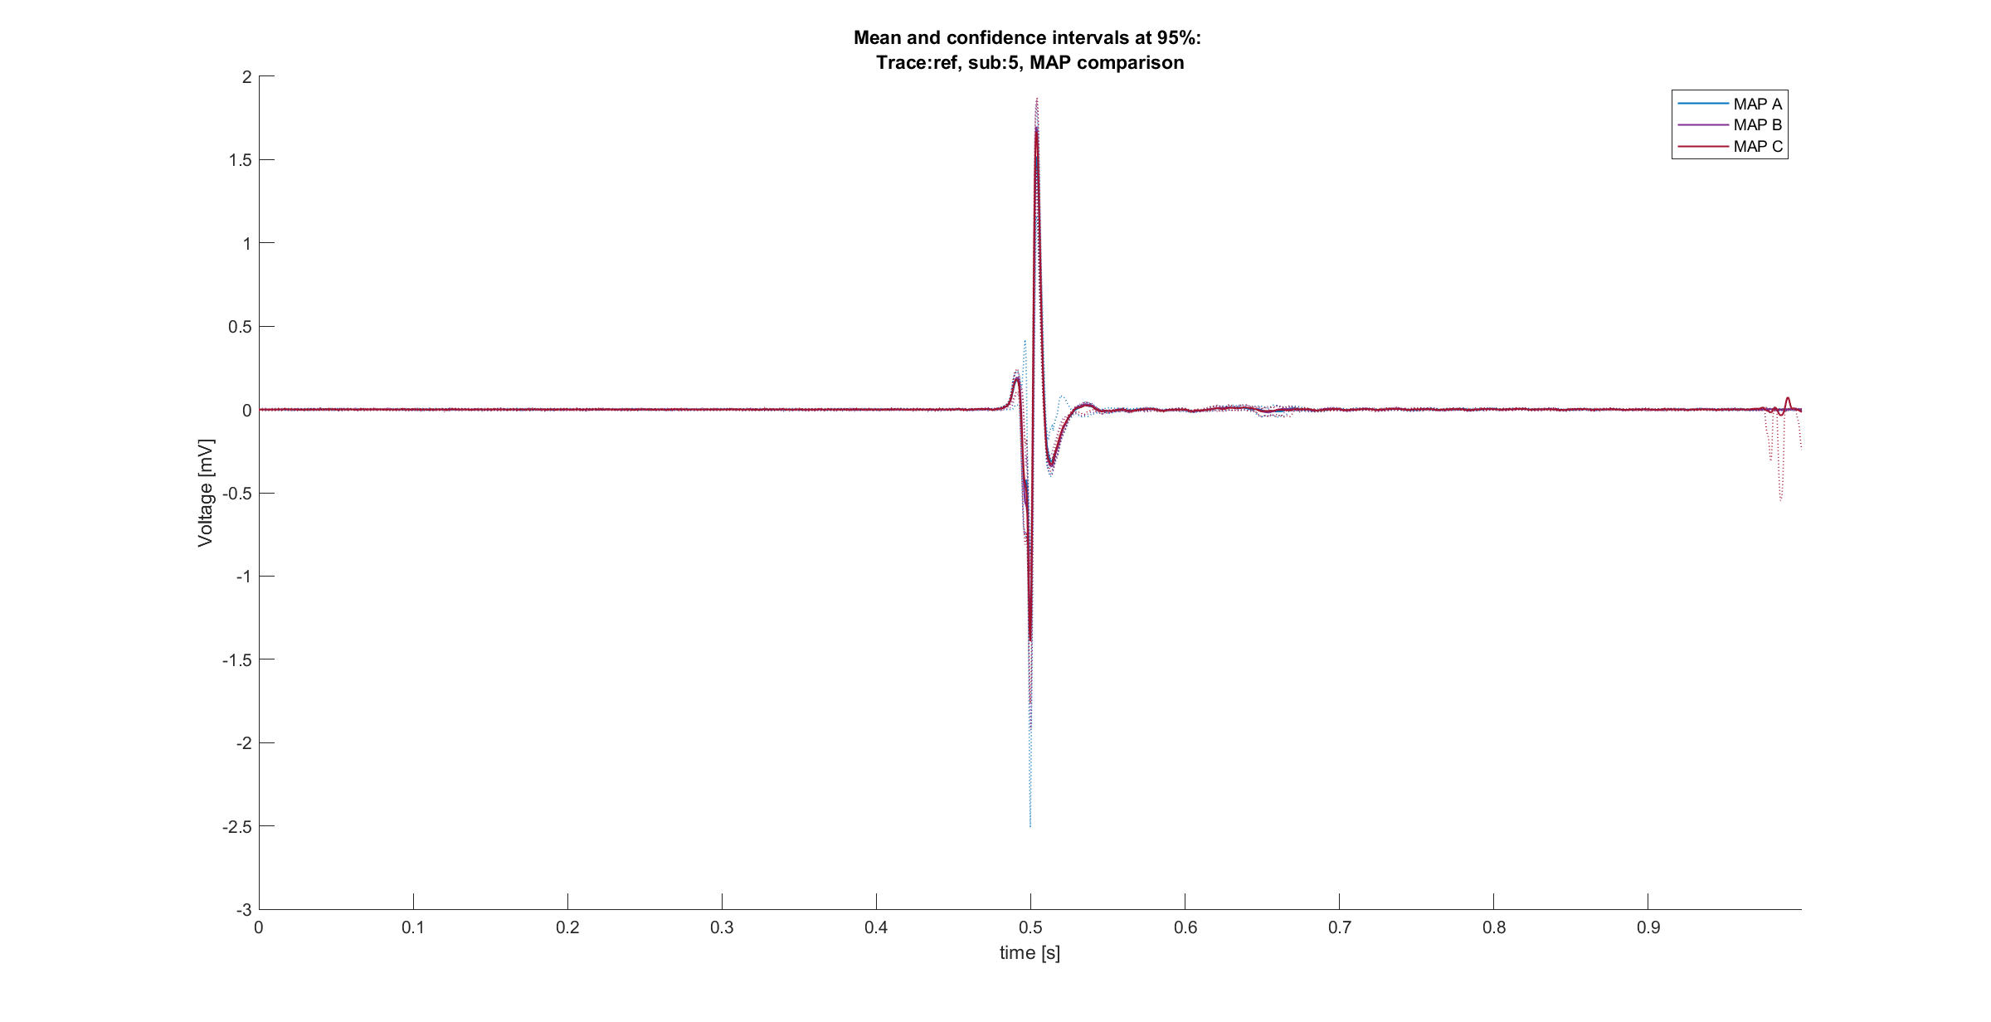
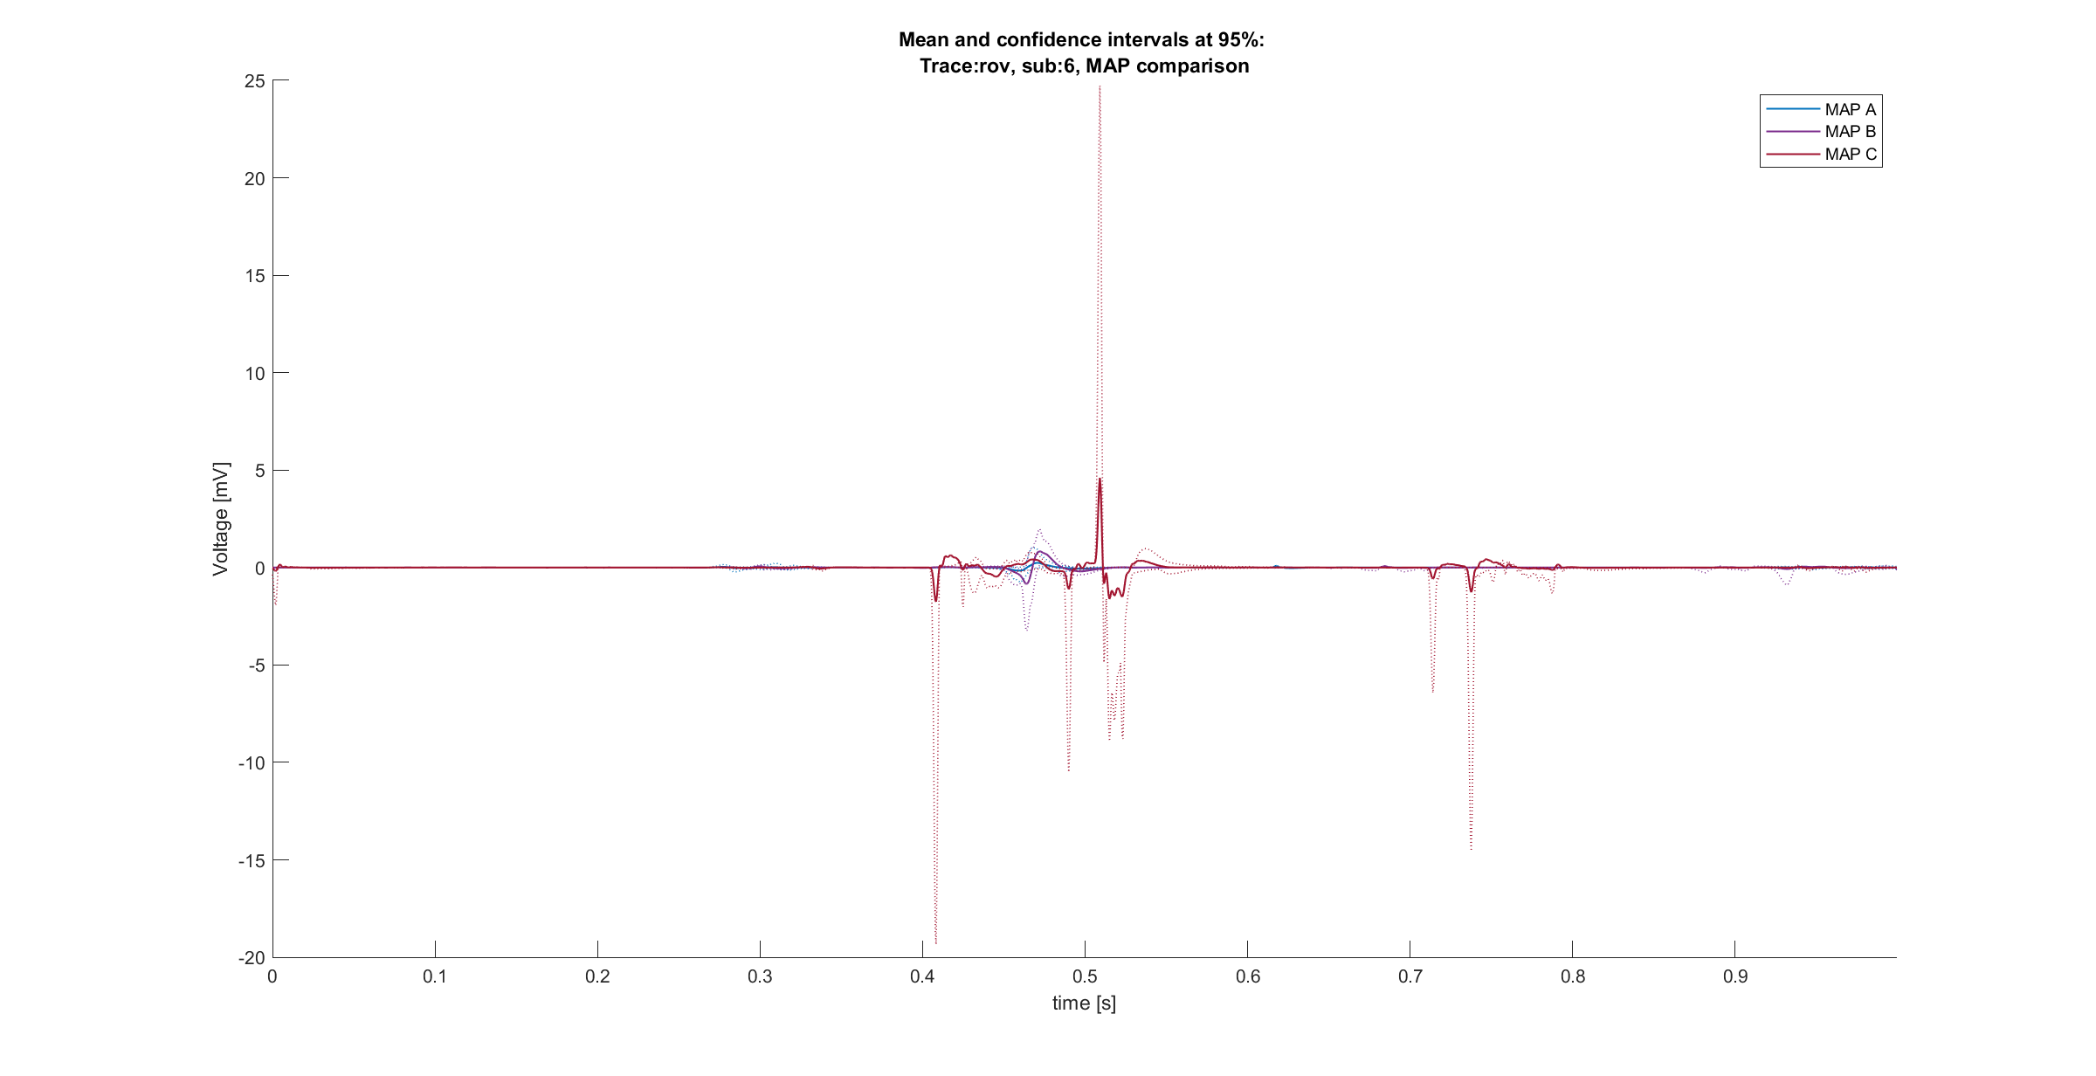
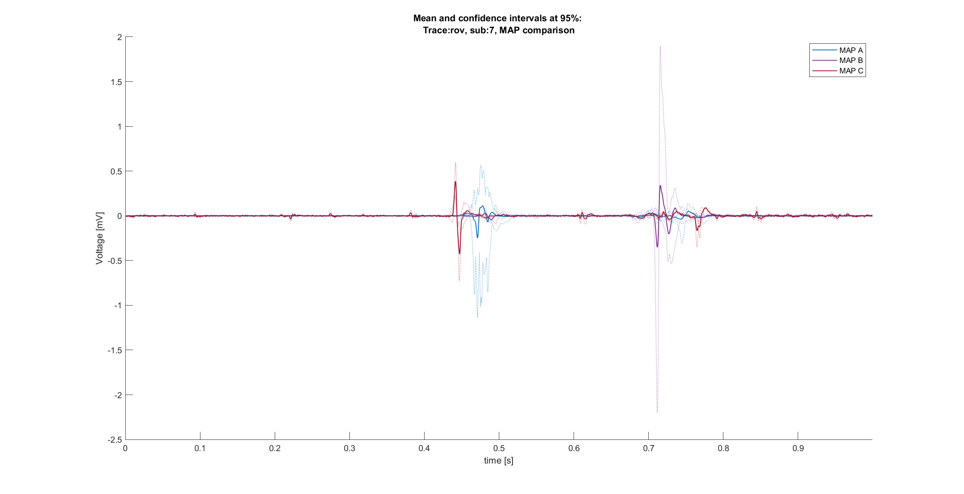
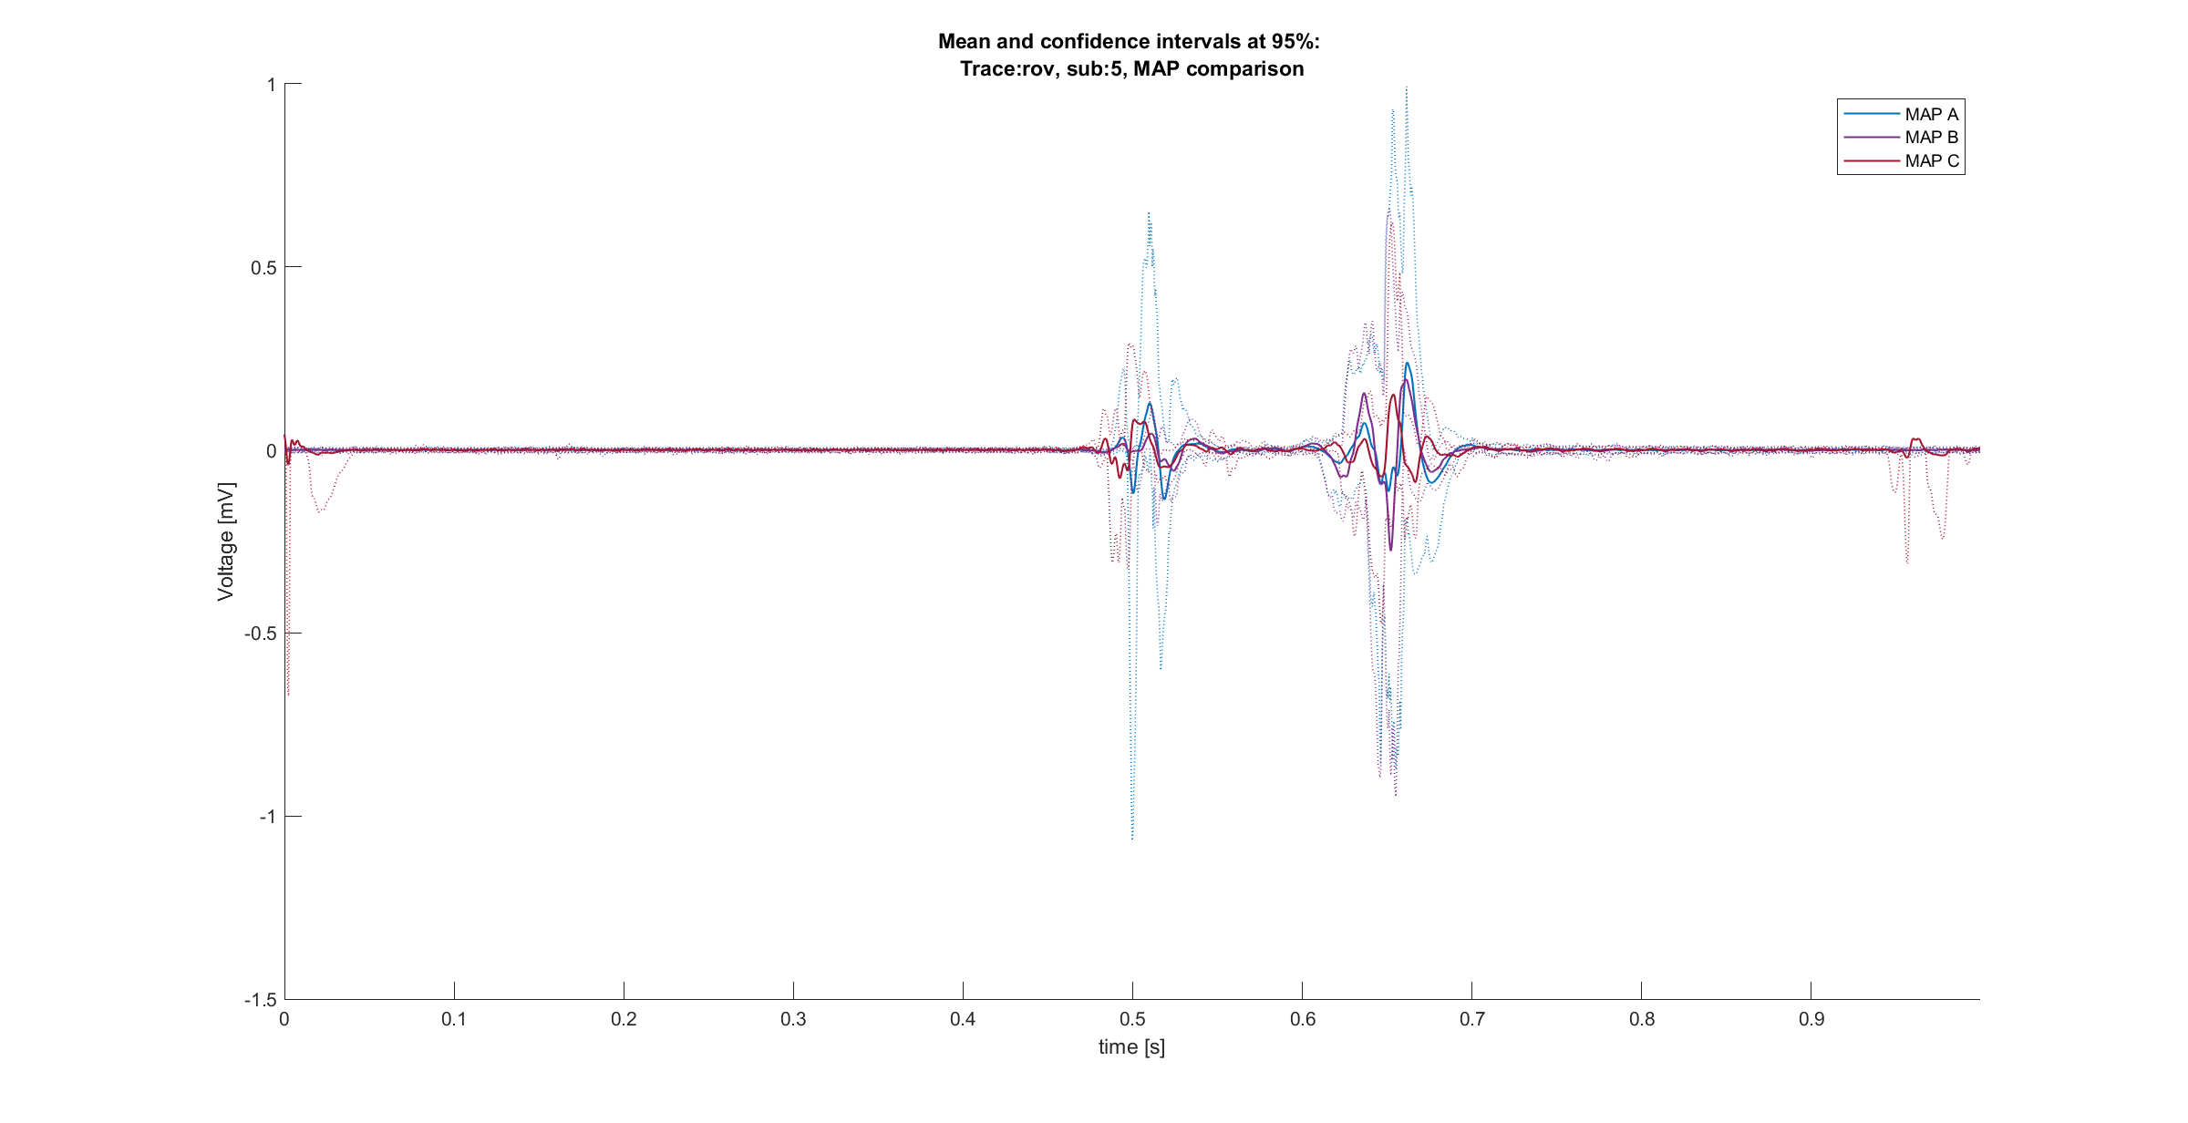
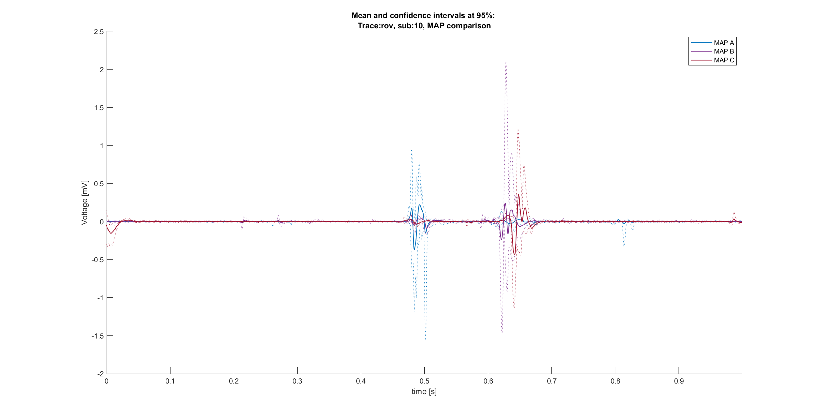
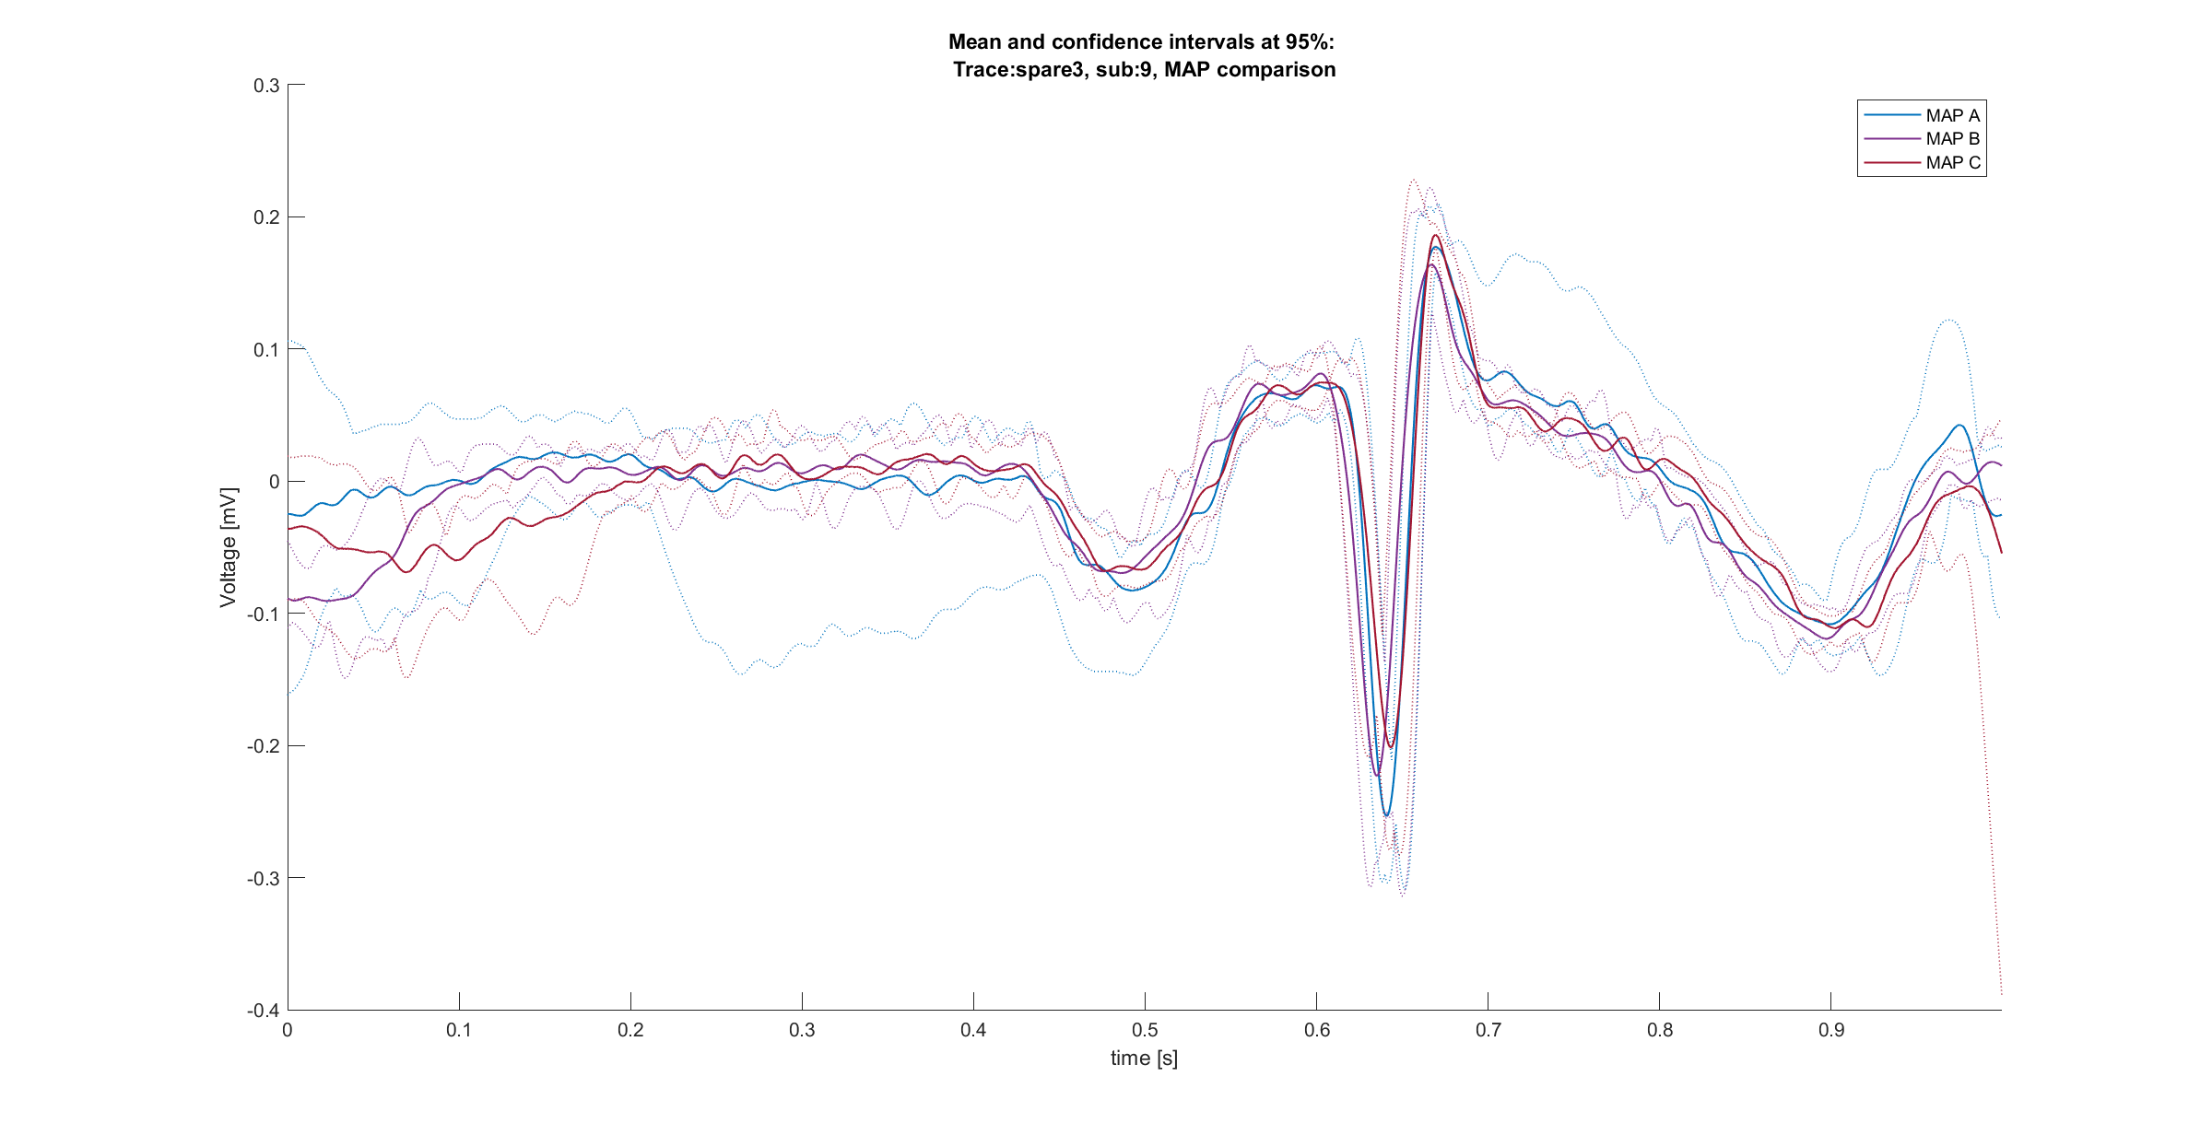
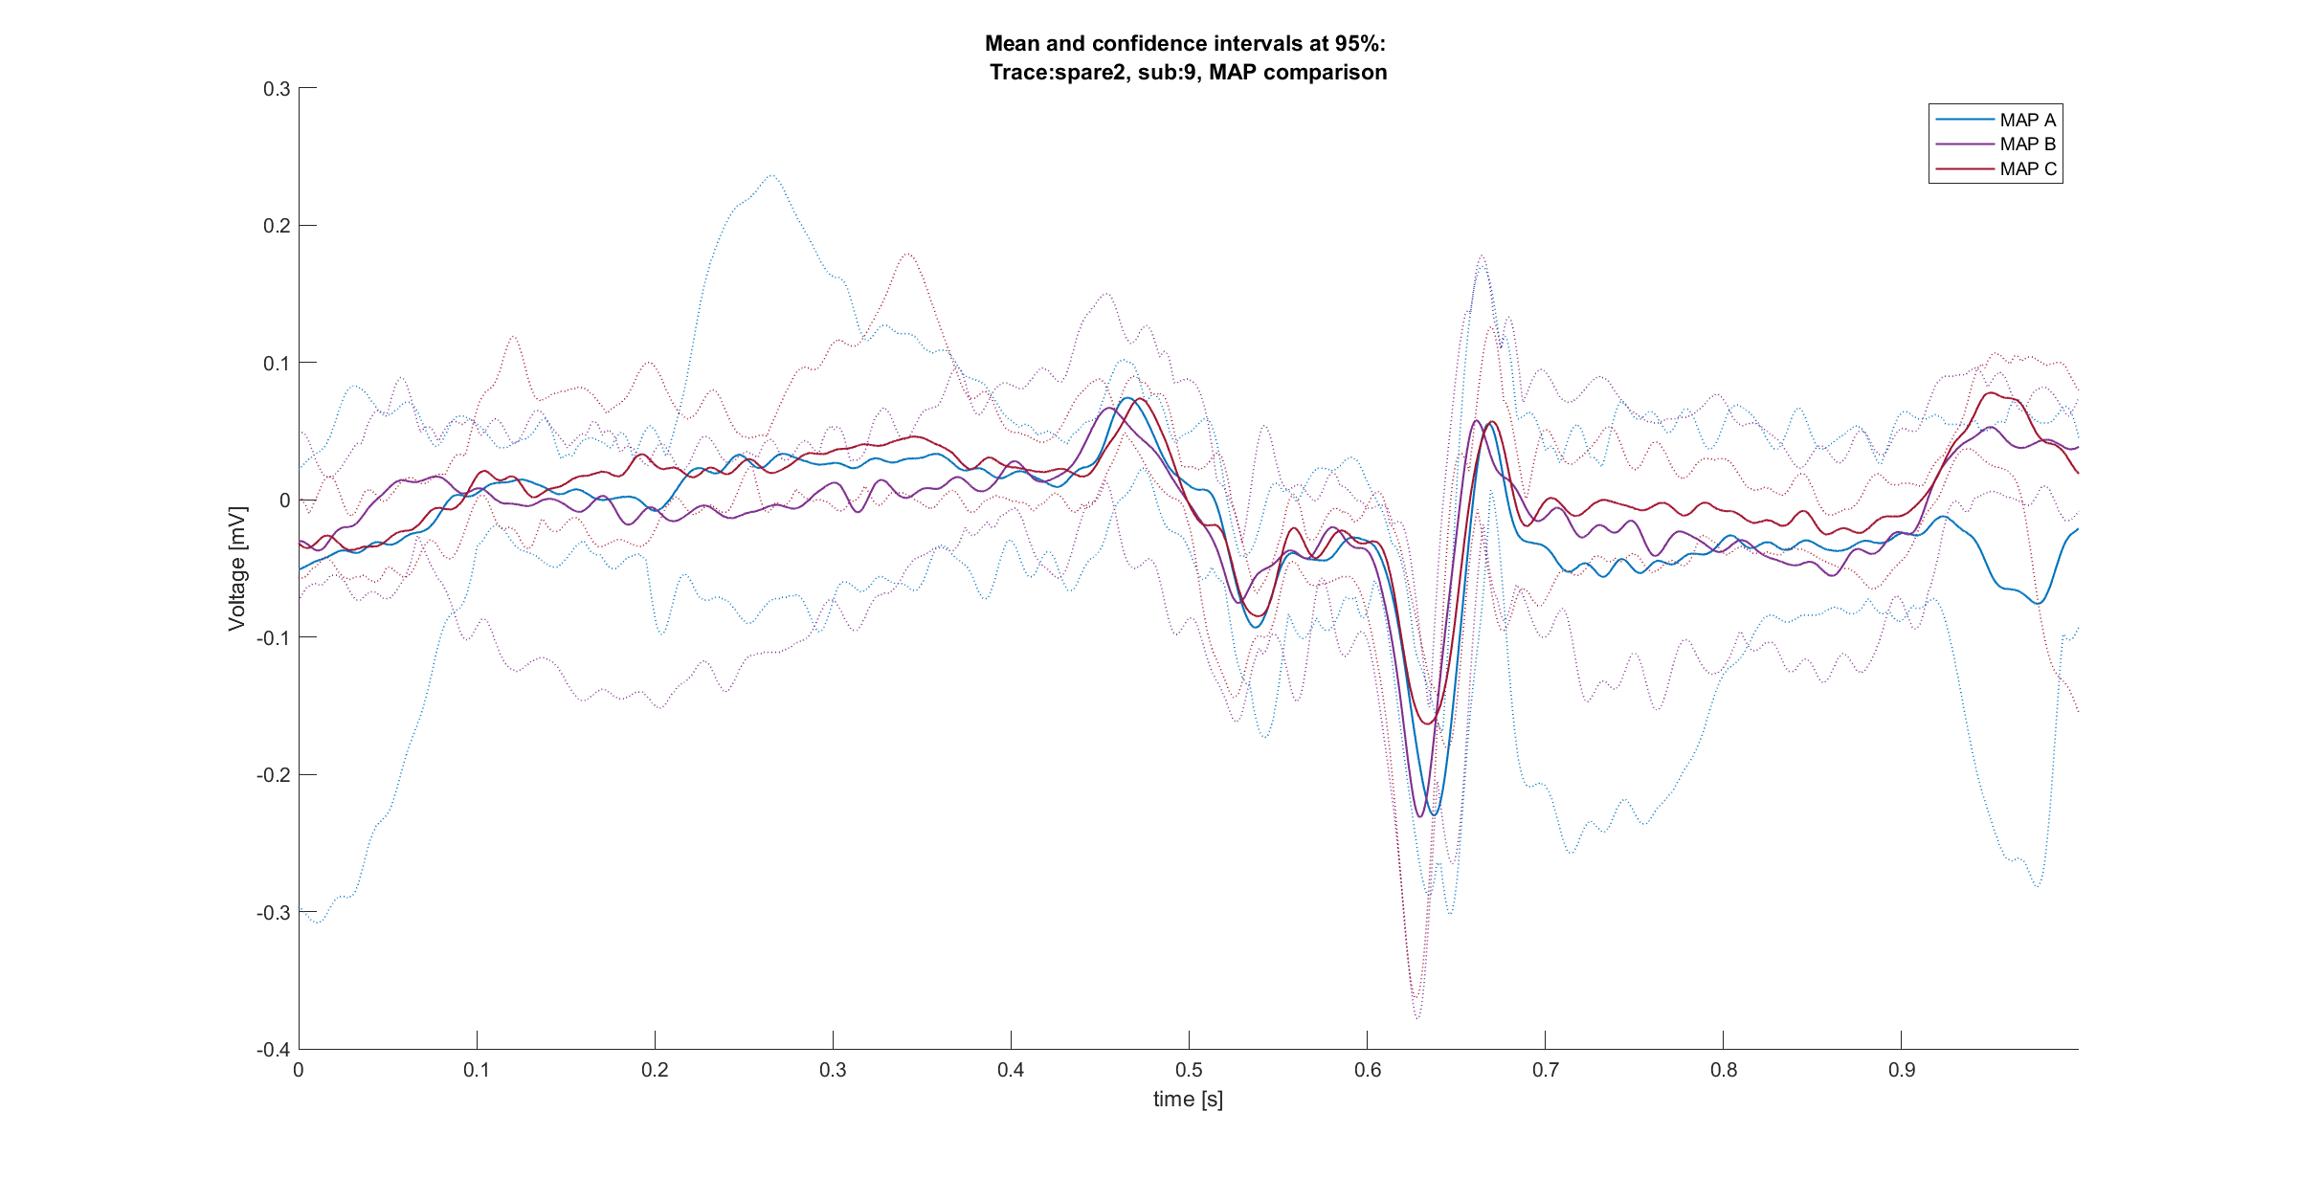
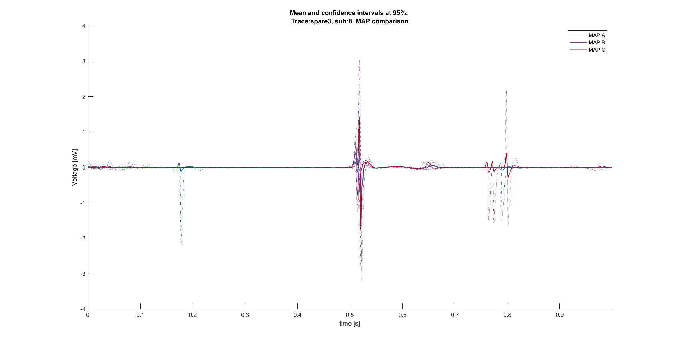
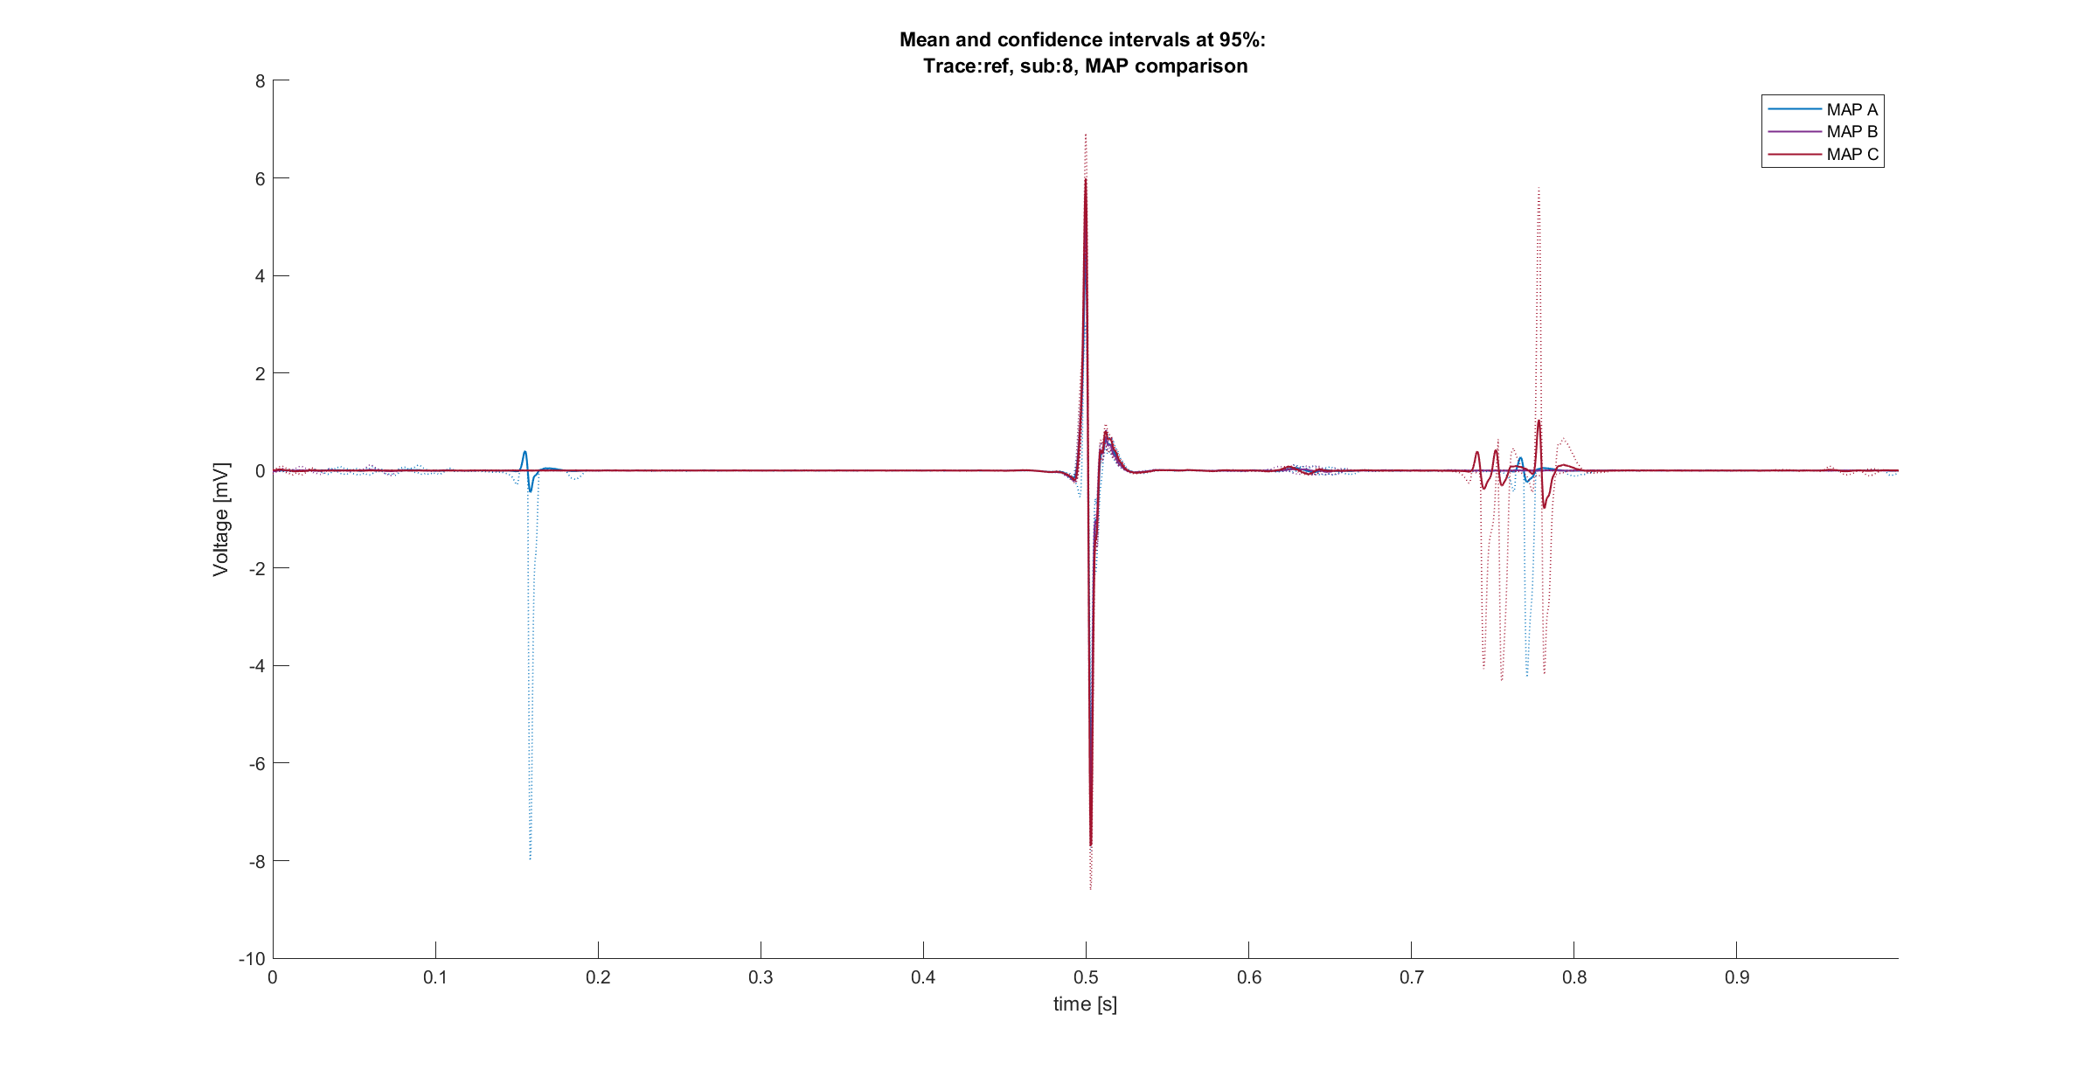
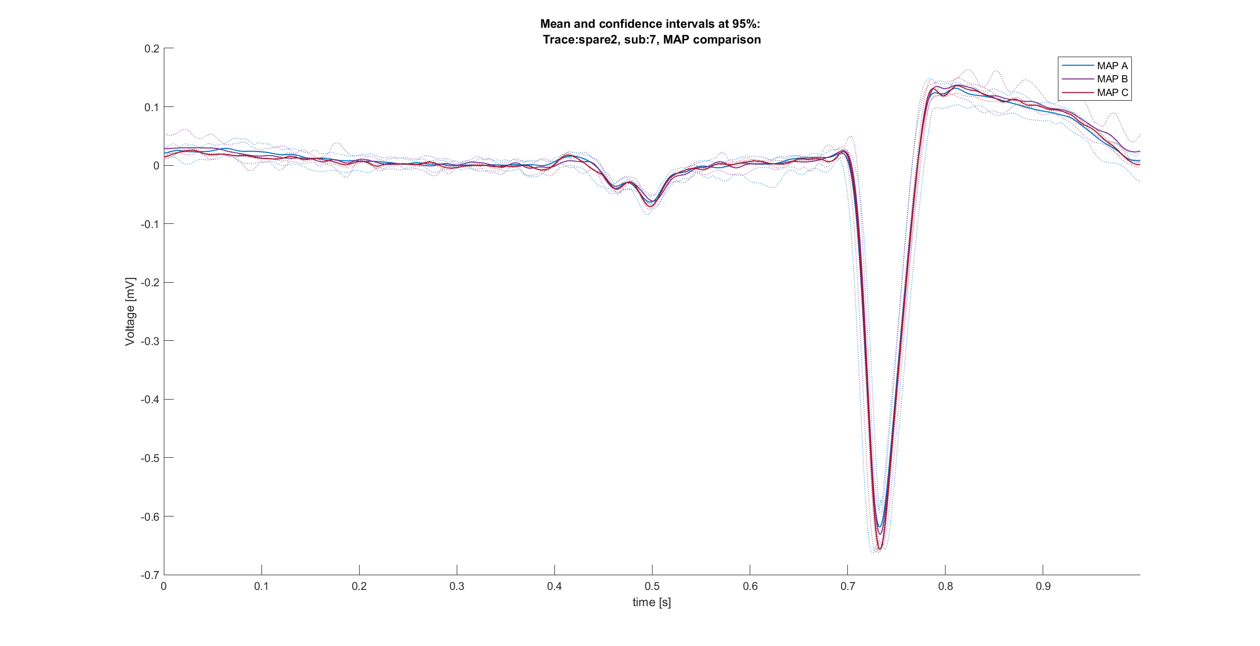
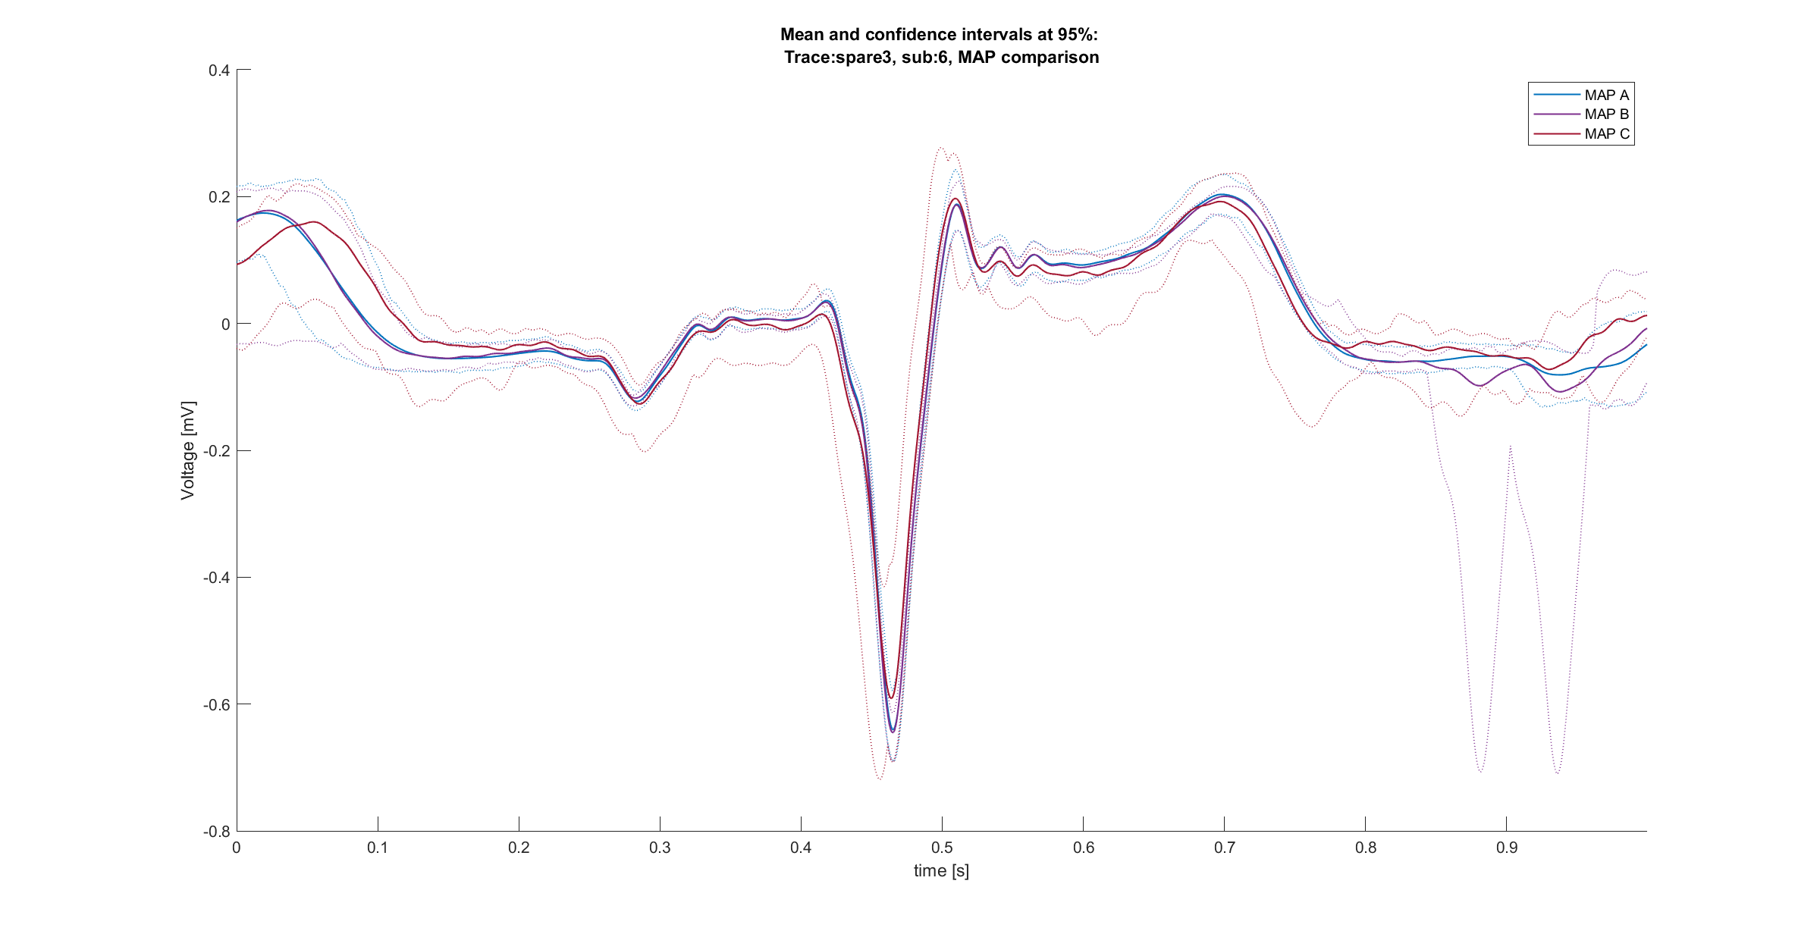
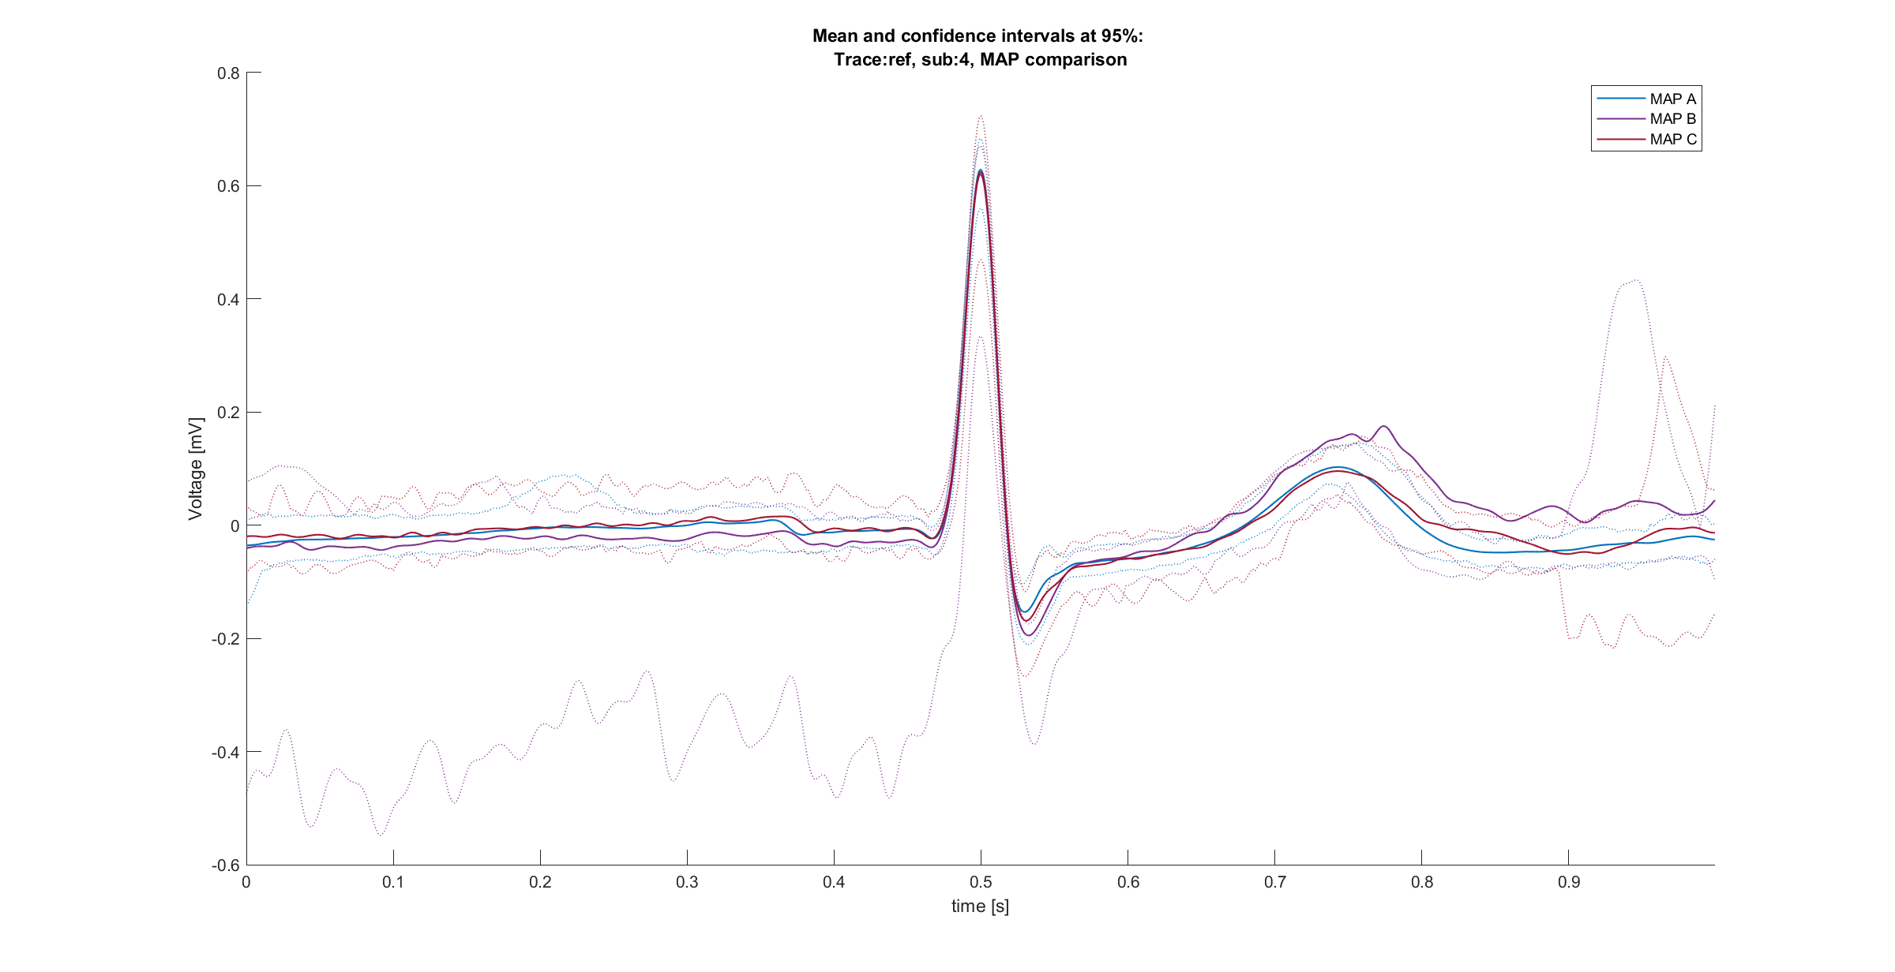





Comparisons between signals [3/3]
Comparisons between maps for the same (mean) signal
Rov trace:
In general, clear difference between maps components
Even if not in all cases
Ref/spare 1 trace:
Certain overlapping between maps
High variability in the shape between subjects
Spare 2 trace:
Certain overlapping between maps
High variability in the shape between subjects
Spare 3 trace:
Certain overlapping between maps
High variability in the shape between subjects

Slide 24
Outline
Data summary and overview
Evaluations on data as population
Evaluation of a priori know characteristics of Rov trace
Comparisons between signals in time domain
Comparisons between signals in frequency domain
Results and Open questions

Slide 25

Methods: spectrum estimation
Spectrum estimation through AR model
$${P_{y}\left(ω\right)=\hat{P}}_{ARMA}\left(ω\right)={\left|H\left(ω\right)\right|}^{2}P_{u}\left(ω\right)={\left|H\left(ω\right)\right|}^{2}σ_{u}^{2}≅{\left|\frac{1}{1+ \sum_{k}^{p}{a_{k}e^{−jωk}}}\right|}^{2}σ_{u}^{2}$$
Spectrum of the target signal
Spectrum of ARMA model
Spectrum of the input signal of the model (white noise)
Transfer function of the AR model which approximates the ARMA one
ARMA models can be approximated by an AR with sufficiently high order
Fast and easy application
Consistent estimation of the spectrum
Order choice is crucial

Slide 26





Methods: order evaluation
Order choosing is done using the AIC criterion into the following pseudo-code:
For each candidate order
Evaluate a model on the signal: $M_{p}^{i}$
Evaluate the AIC of the model: $AIC\left(M_{p}^{i}\right)$
Compare the AIC with the previous one: $\left|AIC\left(M_{p}^{i−1}\right)−AIC\left(M_{p}^{i}\right)\right|<ε$
If the difference is lower than a certain $ε$ save the order as the optimal one, otherwise continue.
If the difference never become lower than $ε$, consider the best order as the one corresponding to the lower AIC.
Then use the optimal order to evaluate the spectrum.
AIC by order
Spectrogram example
AR example
$$AIC=−2Log\left(L_{p}\right)−2p$$

Slide 27






Comparisons between signals, frequency domain [1/3]
Map A example
Map C example
Comparisons between (mean) signals spectrums of different subjects
Map B example
Spectrum information sparser for Rov trace, while for other traces is more concentrated into lower frequences.
In some cases, even the Ref/Spare 1 trace is sparser like the Rov one.
Spectrum in general limited at least at 200Hz, as can be expected from previous studies.

Slide 28












Comparisons between signals, frequency domain [2/3]
Subject signals (mean) spectrums variability
Map B, spare3 trace
Map A, spare2 trace
Map B, spare2 trace
Map A, spare3 trace
Map B, Ref trace
Map A, Ref trace
Rov trace:
Amplitude of components comparable for the same subject
As expected, MAP C has sparser frequency components because of the higher complexity of these signals
Ref/spare 1 trace:
Most of information into the 0-30Hz band, where amplitudes are still comparable
For some subjects there is a higher distribution of the components
Spare 2 trace:
Quite difficult distinguish between maps just by looking at spectrums.
Components between 0 and 40Hz.
Spare 3 trace:
Quite difficult distinguish between maps just by looking at spectrums.
In some cases, sparser components
Map A, Rov trace
Map B, Rov trace
Map C, spare3 trace
Map C, spare2 trace
Map C, Rov trace
Map C, Ref trace

Slide 29















Comparisons between signals, frequency domain [3/3]
Comparisons between maps for the same (mean) signal spectrum
Rov trace:
Not clear differences between maps in term of frequency components separability
Certain variability between amplitudes
Ref/spare 1 trace:
Overlapping between maps
Considerable variability between subjects in terms of frequency components distribution and amplitude, but these difference persist between maps, making them not clearly distinguishable
Spare 2 trace:
Overlapping between maps
In general, spectrum concentrated between 0 and 40Hz independently from maps
Spare 3 trace:
Overlapping between maps
In general, spectrum concentrated between 0 and 40Hz independently from maps

Slide 30
Outline
Data summary and overview
Evaluations on data as population
Evaluation of a priori know characteristics of Rov trace
Comparisons between signals in time domain
Comparisons between signals in frequency domain
Correlation analysis between maps
Results and Open questions

Slide 31
Results and open questions
Results
Time domain suggest differences between maps for the Rov trace. On the other hand, other signals does not differ so much between maps, while differs within subjects.
Frequency domain confirms that the Rov trace is, in general, richer of high frequency components, while low frequency components are more represented in other traces.
Open questions
Does the signals need to be aligned respect to a certain component of the reference (i.e., P wave)?
Which is the nature of “spare” signals? Are they bipolar derivations or aVR, aVF, and aVL?
Is possible a misclassification of some signals?
How to be sure about the components of the signals? How can we distinguish clearly between atrial and ventricular components?
Is it acceptable the variable founded into the shape of reference signals?
Is what I found in agreement with the expectations on these signals?
Are there some analysis that worth to be done in addition to the ones done so far?
Are there some important considerations that I missed?

Slide 32



Correlation Analysis
As probably the most interesting trace is the Rov trace, correlation analysis is done on this trace.
Scope: find if Rov traces (mean) are correlated between maps.
Method:
$R^{2}$coefficient is evaluated for each map pair (A-B, A-C, B-C) and collected for each subject. As result we get 3 vectors of $R^{2}$.
Boxplots of $R^{2}$ distribution are then built for these vectors
Paired T-Test between $R^{2}$ vectors are done to assess differences
Results:
From boxplot is appreciable the different distribution between $R^{2}$. Maps A-B seems to positively correlated in some cases, while comparisons with map C return an overall lower correlation, suggesting that maps A and B are less correlated with map C.
T-Test results suggest that the correlation between maps A-B and B-C is significantly different, which agrees with considerations made before. On the other hand, other cases does not evidence significant differences. It worth to be noted that even if $R^{2}$ between A-B and B-C are not significantly different, p-value is low.
$R^{2}$ t-test | (A-B) vs (A-C) | (A-B) vs (B-C) | (B-C) vs (A-C)
Null HP | 0 | 1 | 0
p-value | 0,098 | 0,047 | 0,47

